Slide 1
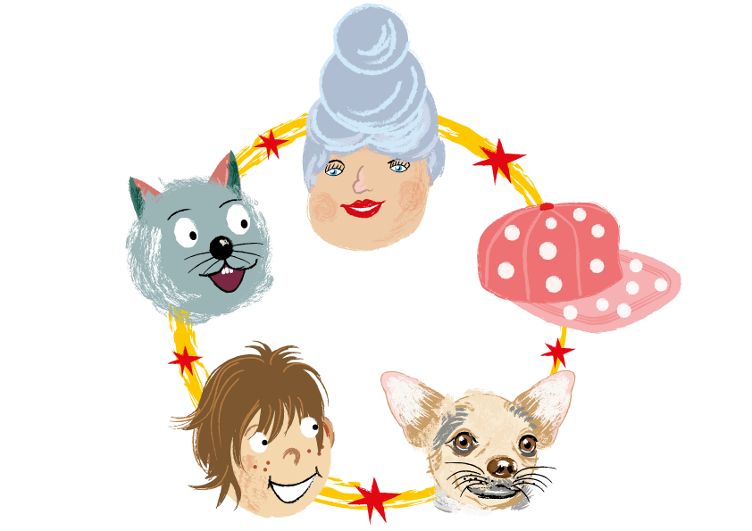
Rhymes

Slide 2
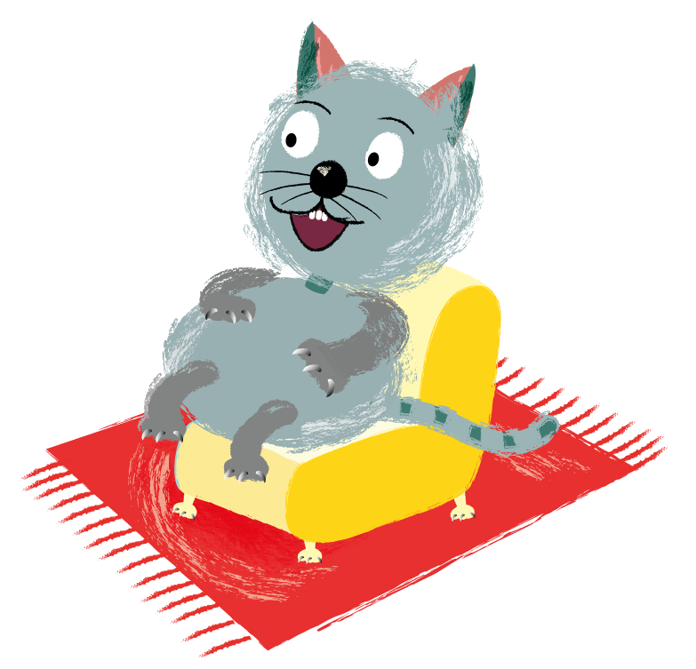
I can see a fluffy grey cat.
She is sitting on my red mat.

Slide 3
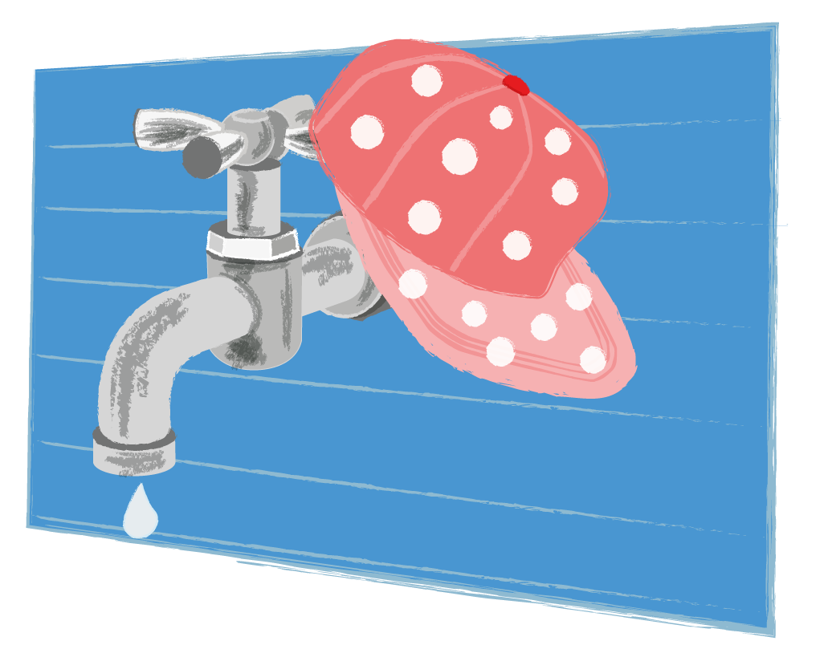
There is a spotted cap.
It’s near the water tap.

Slide 4
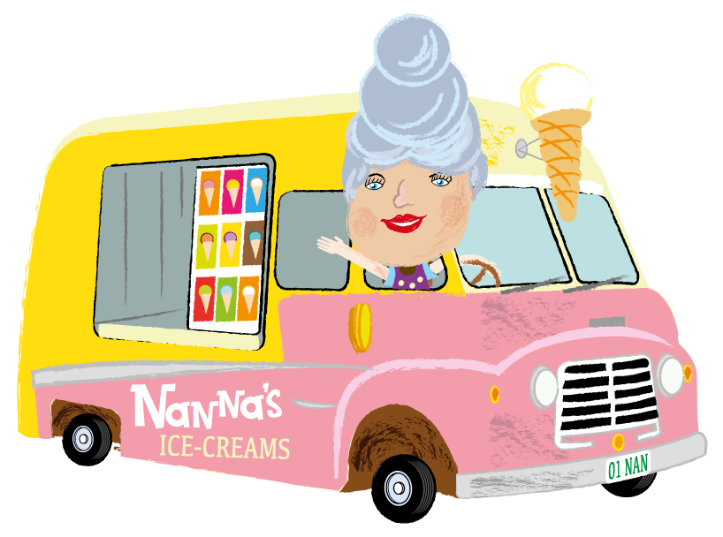
Here is Timothy’s Nan.
She drives the ice-cream van.

Slide 5
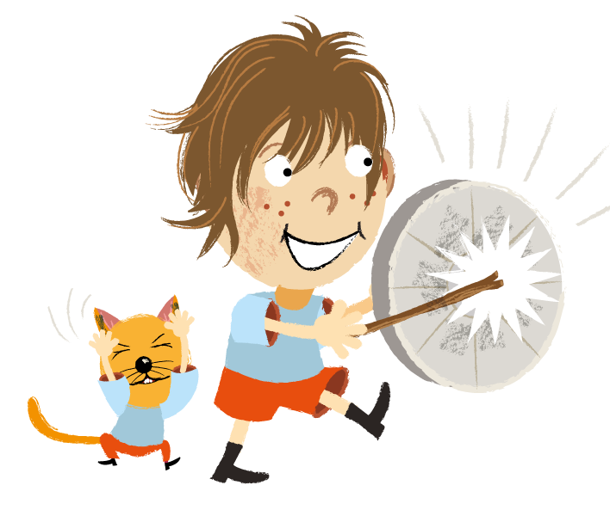
I can make a big loud din.
I will bang the rubbish bin.

Slide 6

I can see a dog called Nip. He sits on a lady’s hip.

