Slide 1
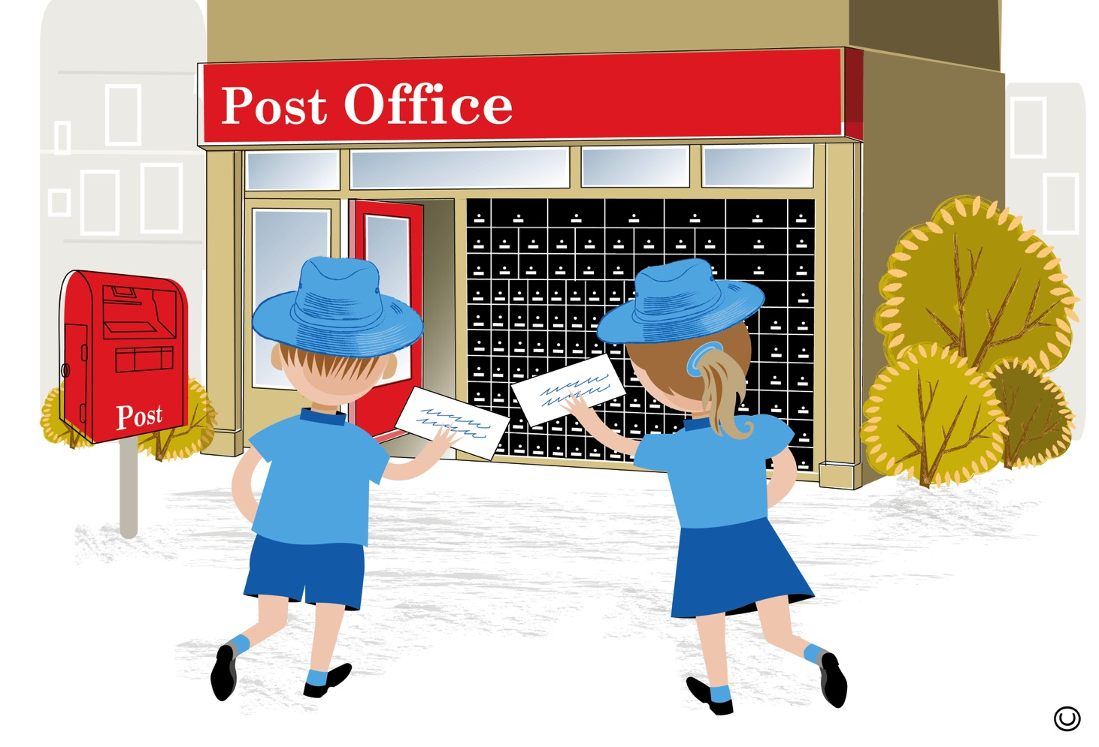
A visit to the post office
Notes:
A visit to the post office.

Slide 2
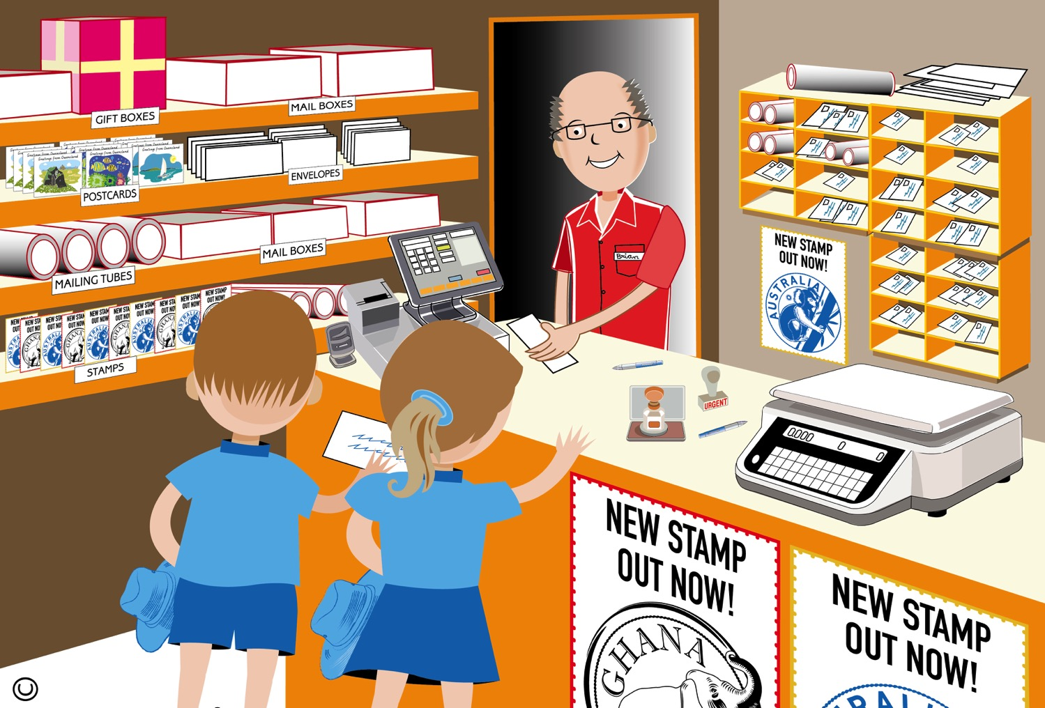
Notes:
These children have come to the post office to send a letter to a friend in Rockhampton. They are wondering what happens when a letter is posted. What can you see in this part of the post office? What things can we buy at the post office? What equipment is the post office worker using? What is the post office worker wearing?
The post office worker has taken the children’s letters and put stamps on them to show that they have paid their postage. Can you see the machine beside the post office worker? These are called scales and at the post office the post office worker may use these to weigh a letter or parcel to see how much money it will cost to send it. Can you see the special stamps on the desk that the post office worker can use? One of the stamps has a word on it. It says ‘urgent’. The post office worker will use this if a letter or parcel needs to be delivered quickly. Have you ever wondered what happens when you post a letter?

Slide 3
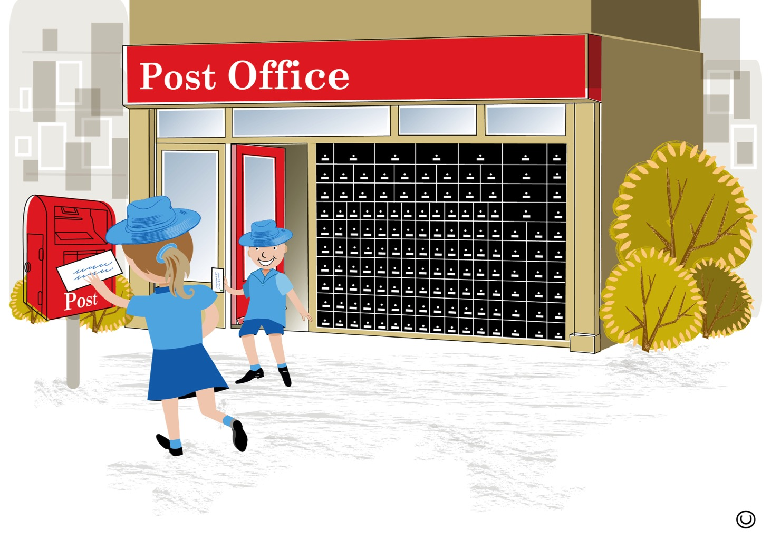
Notes:
Now that the children’s letters have stamps they can post them in the special post box outside the post office. Have you ever posted a letter like this before? The children are wondering what will happen to their letters now? They are going to go back inside the post office to find out.

Slide 4
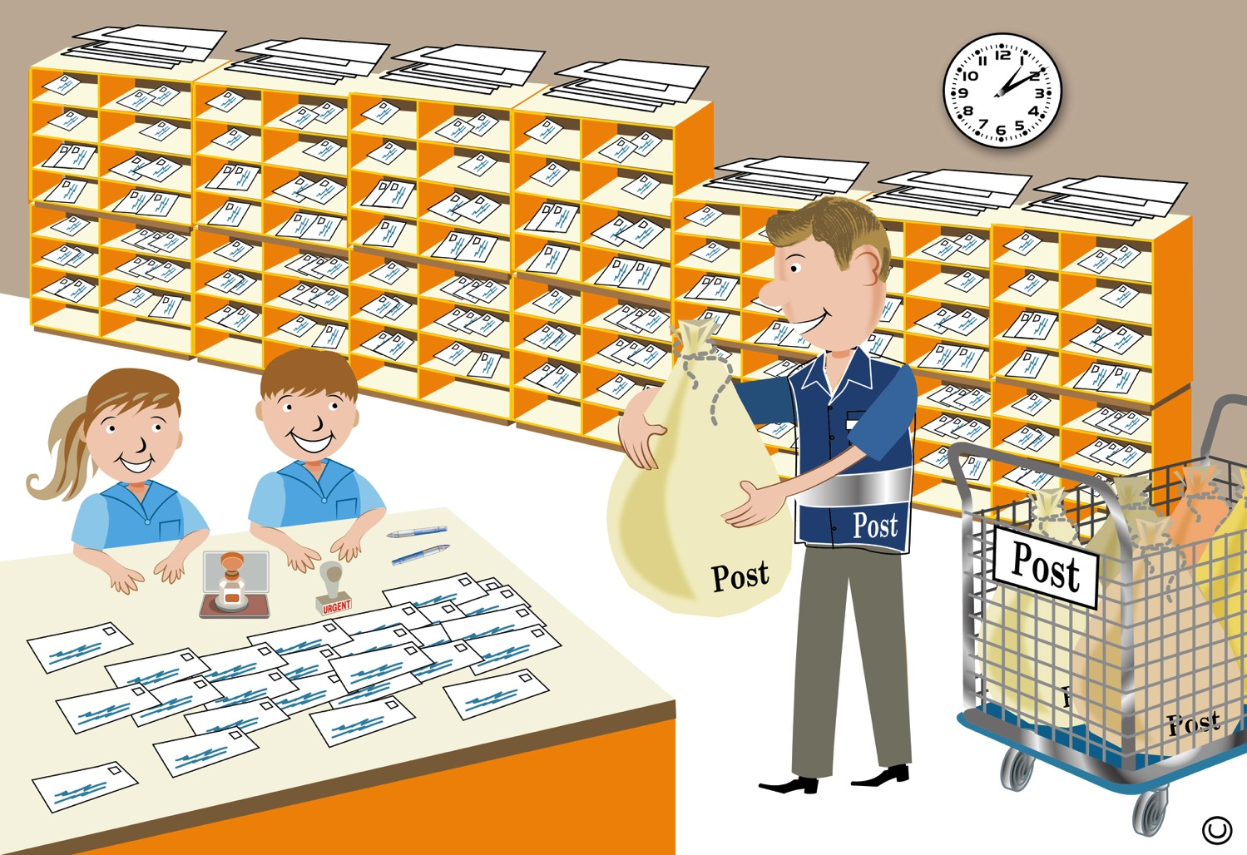
Notes:
The children are now in another part of the post office. What can you see? I wonder what is in the bag that this post office worker is holding? At the end of each day the outside mailbox is emptied. All the letters are carefully placed into these bags. Can you see some letters on the table? These letters will be sorted and organised so that they can be delivered to the right places. What other things can you see that the postal office worker might use when they sort out all the letters?

Slide 5
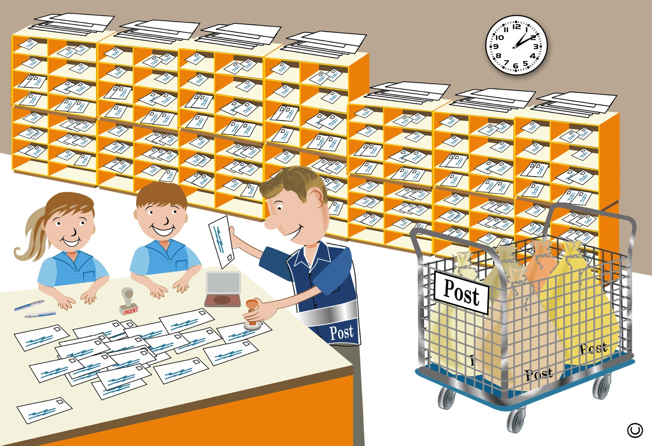
Notes:
The post office worker is stamping all the letters with the date stamp to say what day the letter was posted. The letters are then organised using the special shelves you can see behind the post office worker. Each shelf holds all the letters and parcels that are going to the same place. Once all the letters are date stamped and organised, the post office worker puts them into the bags that you can see in the crate on the trolley.

Slide 6
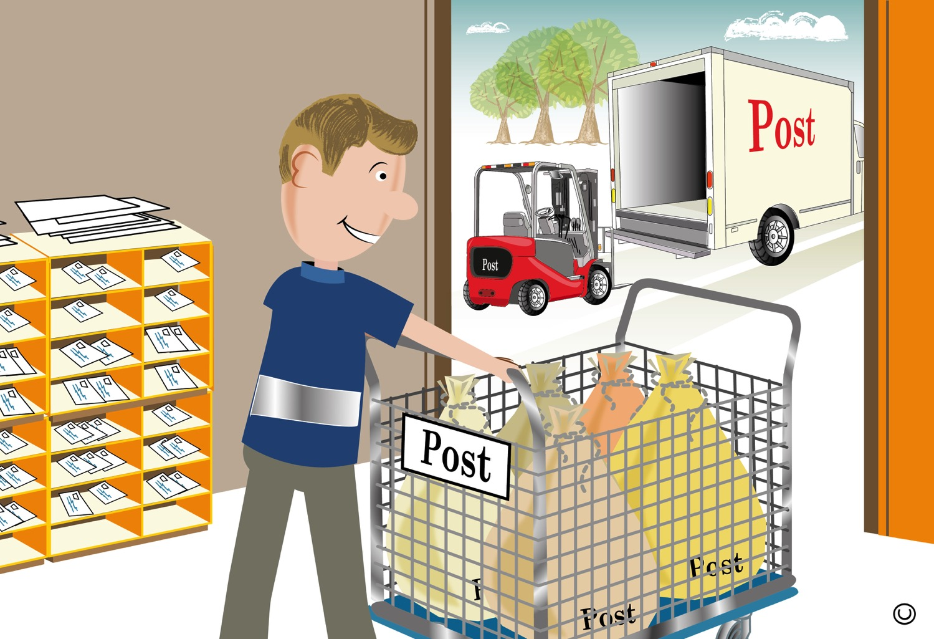
Notes:
The post office worker then wheels the bags of letters to the back of the post office. Another postal worker will use a forklift to lift the crate of letters into the back of the postal truck. The letters are then transported to the post office in the city that they are going to where they will be delivered to each address written on the front of each letter.

