Slide 1
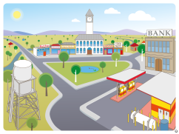
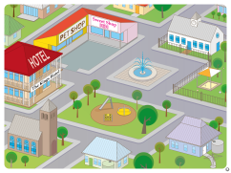
Shape towns
Click on a town picture to see a large town picture.
Try to find 2D shapes and 3D objects in the town.
When you can see the ‘hand’, click to have a closer look.
Notes:
Composite shapes
https://learningplace.eq.edu.au/cx/resources/file/ac53f421-0e4b-eebd-9f21-8e5a137cfa40/1/Composite_shapes.mp4

Slide 2
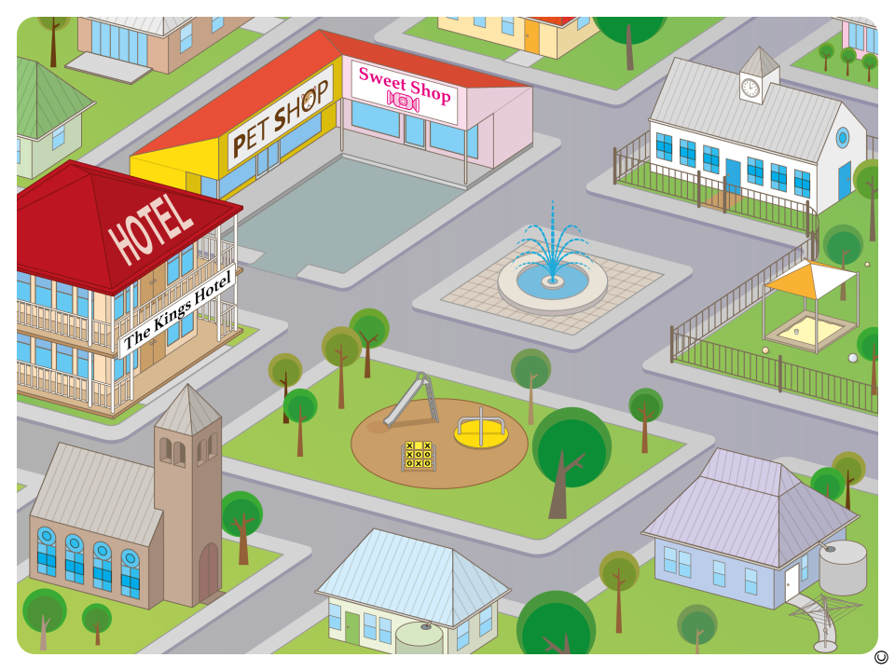


Slide 3

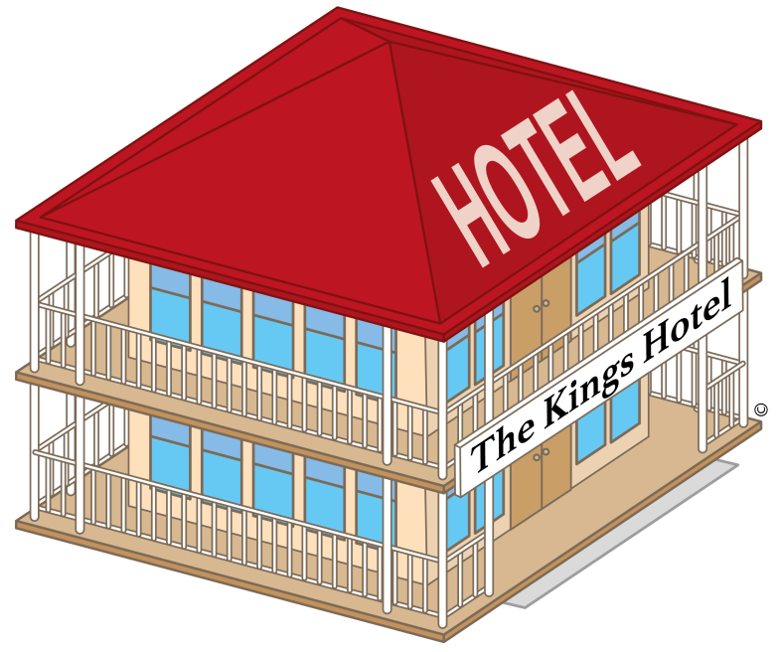


Slide 4
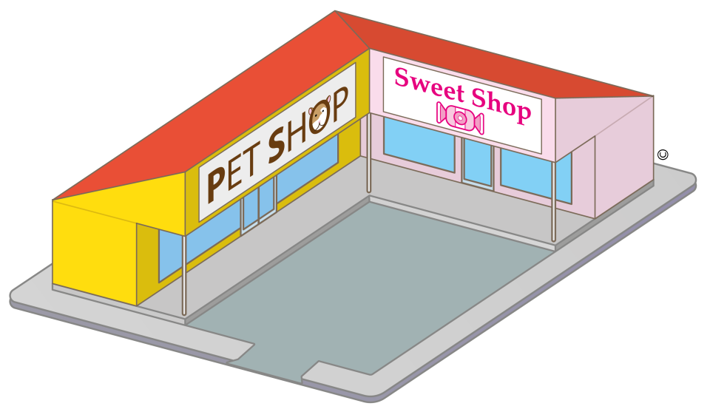

Slide 5
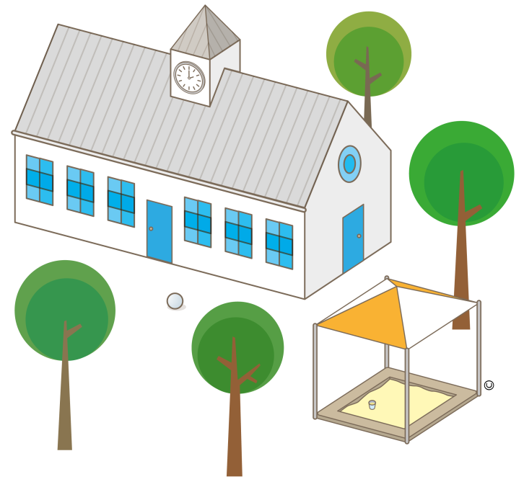

Slide 6
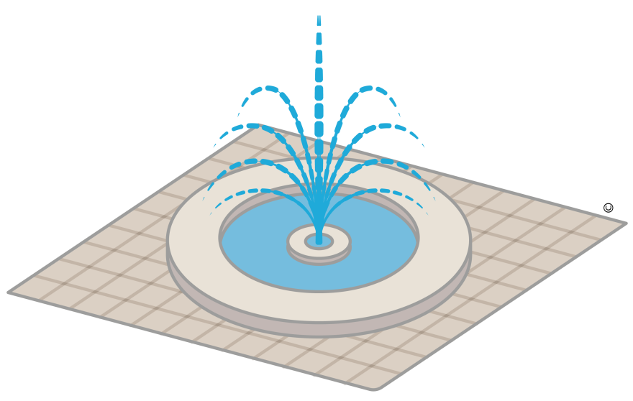

Slide 7
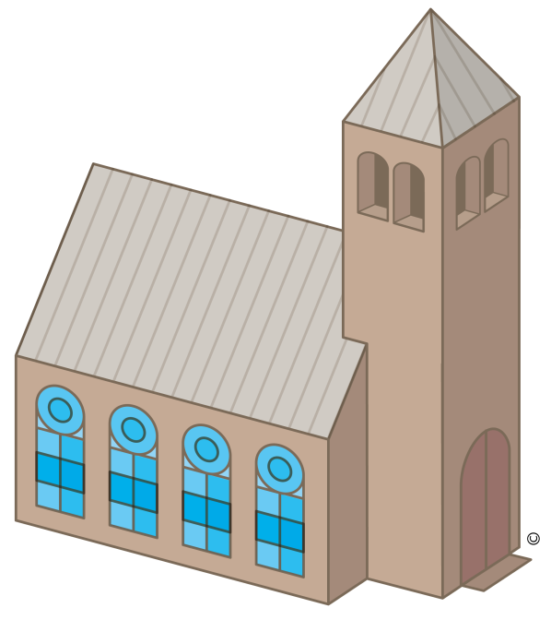

Slide 8


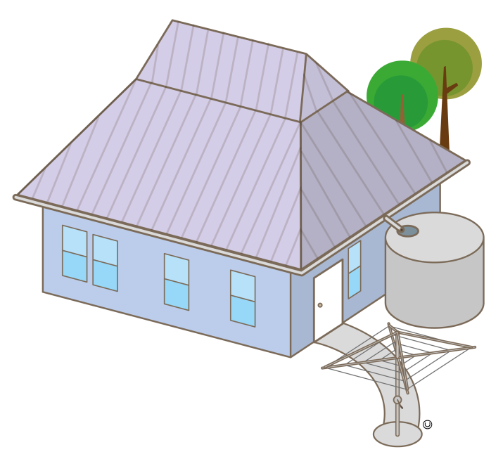

Slide 9
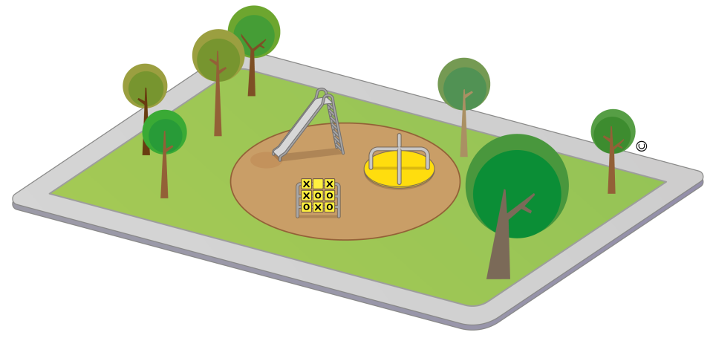

Slide 10
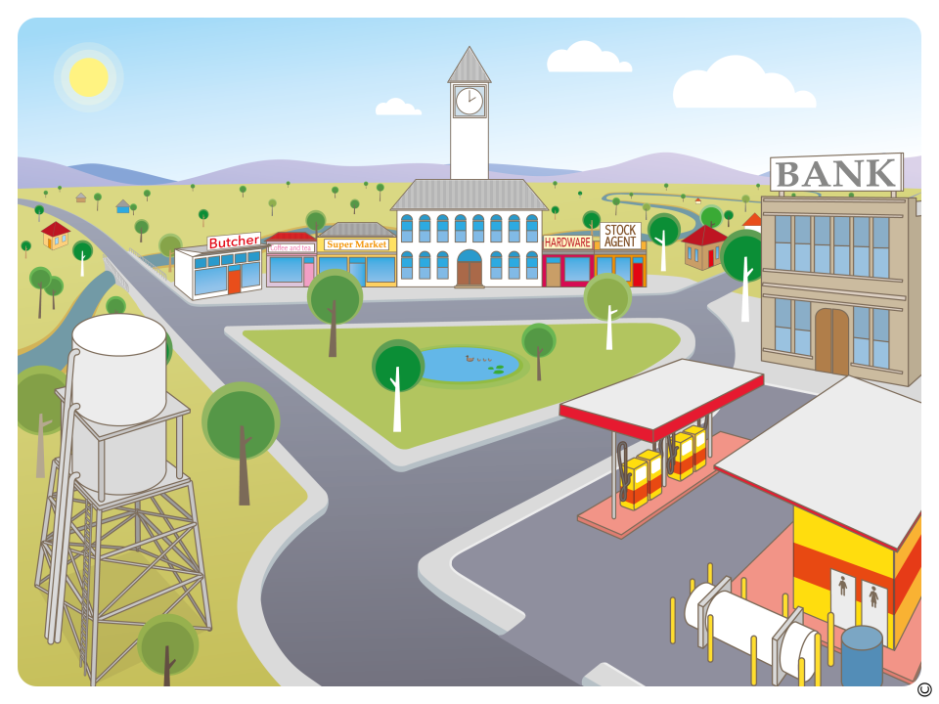

Slide 11
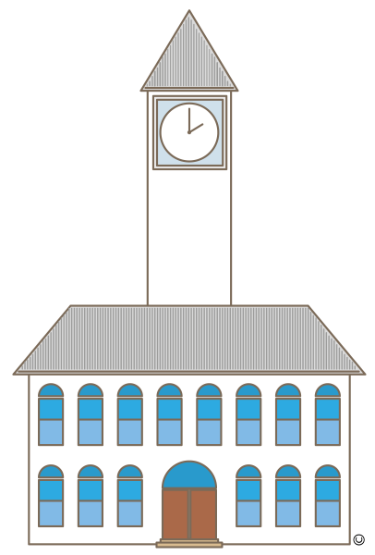

Slide 12
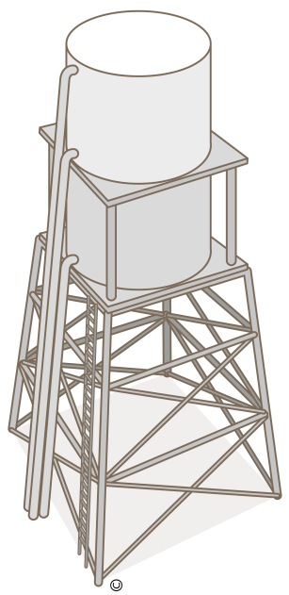

Slide 13
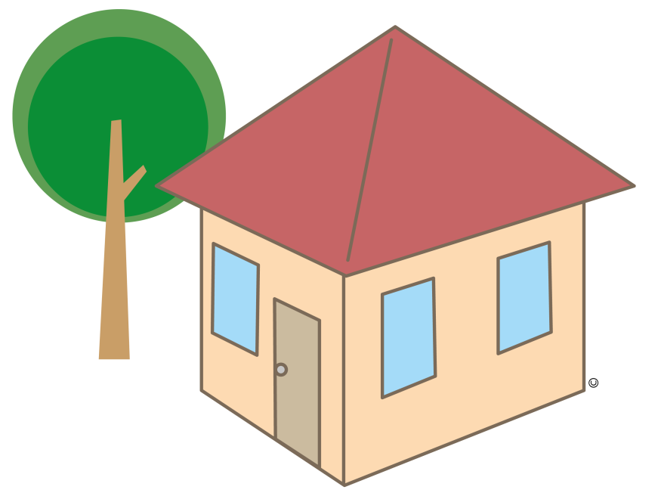

Slide 14
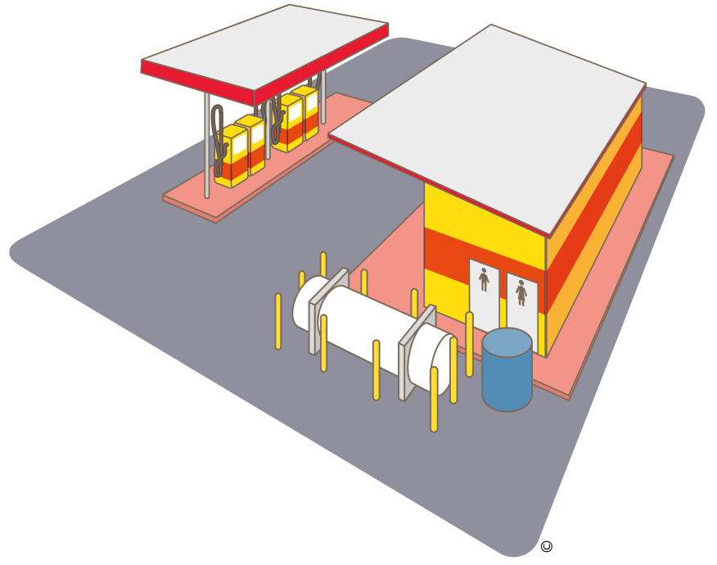

Slide 15


