Slide 1

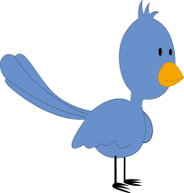

Ollie’s ornaments

Slide 2
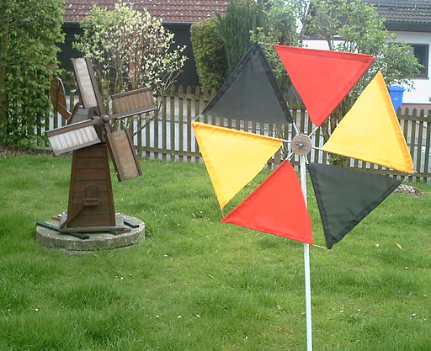
Whirring windmill
Made from nylon fabric and plastic
Engelhardt , R. Wind chime http://commons.wikimedia.org/wiki/File%3A2010-05-11-Windspiel.JPG
CC BY-SA 3.0 creativecommons.org/licenses/by-sa/3.0/deed.en

Slide 3
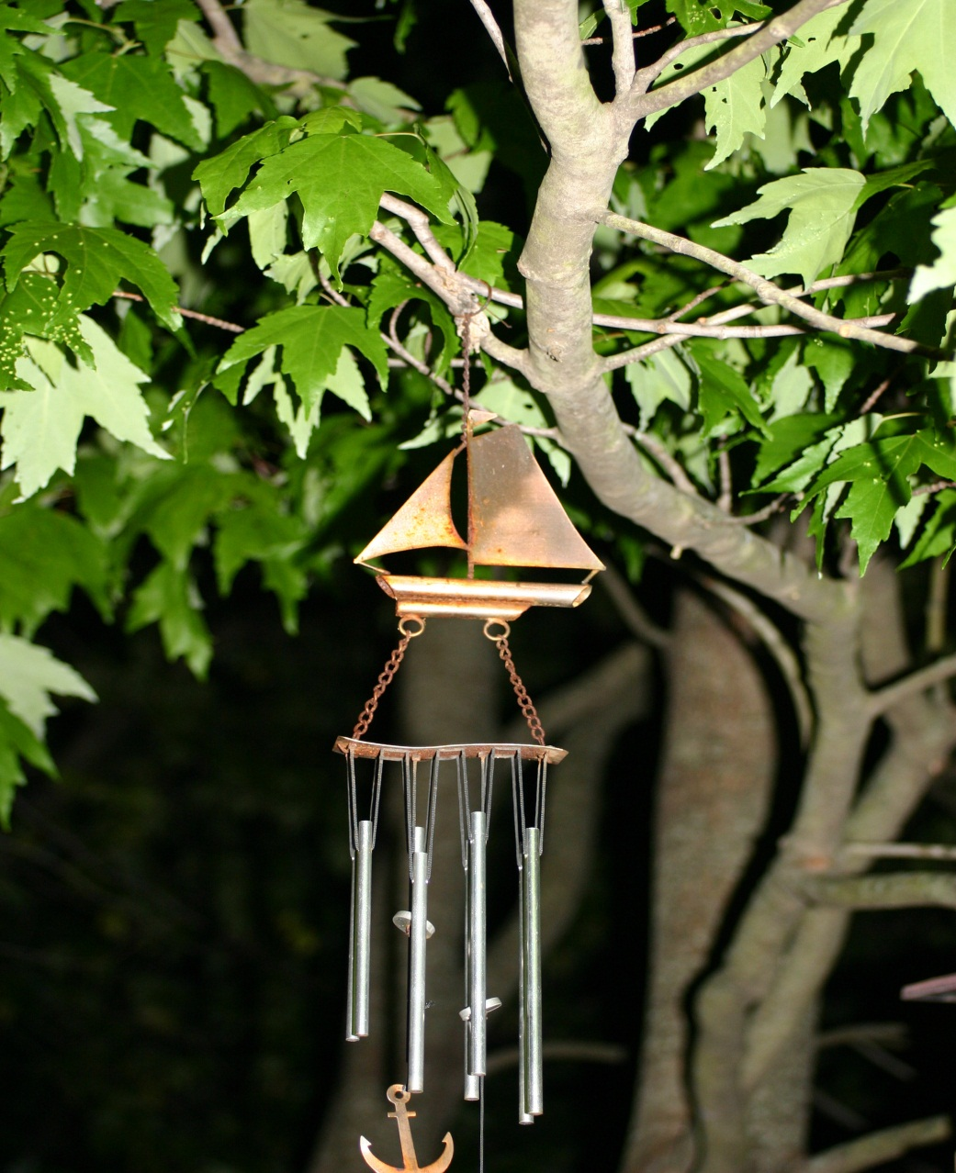
Sailing ship
Made from metal
http://mrg.bz/VPzrPp

Slide 4
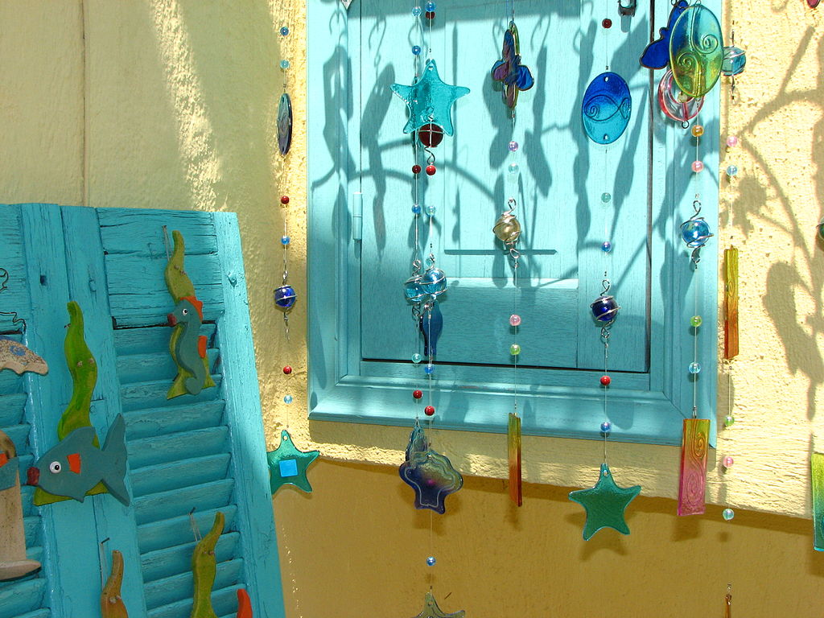
Glassy chimes
Made from glass, metal and fishing line
Adamantios, Wind chimes http://commons.wikimedia.org/wiki/File%3AGlass-wind-chimes.jpg
CC BY-SA 3.0 creativecommons.org/licenses/by-sa/3.0/deed.en

Slide 5
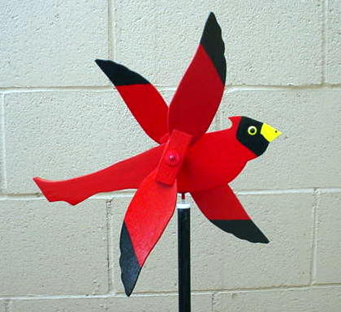
Racing red bird
Made from wood and metal
CDSblair, Whirligig http://commons.wikimedia.org/wiki/File%3ACardinal_Whirligig.jpg
CC BY-SA 3.0 creativecommons.org/licenses/by-sa/3.0/deed.en

Slide 6
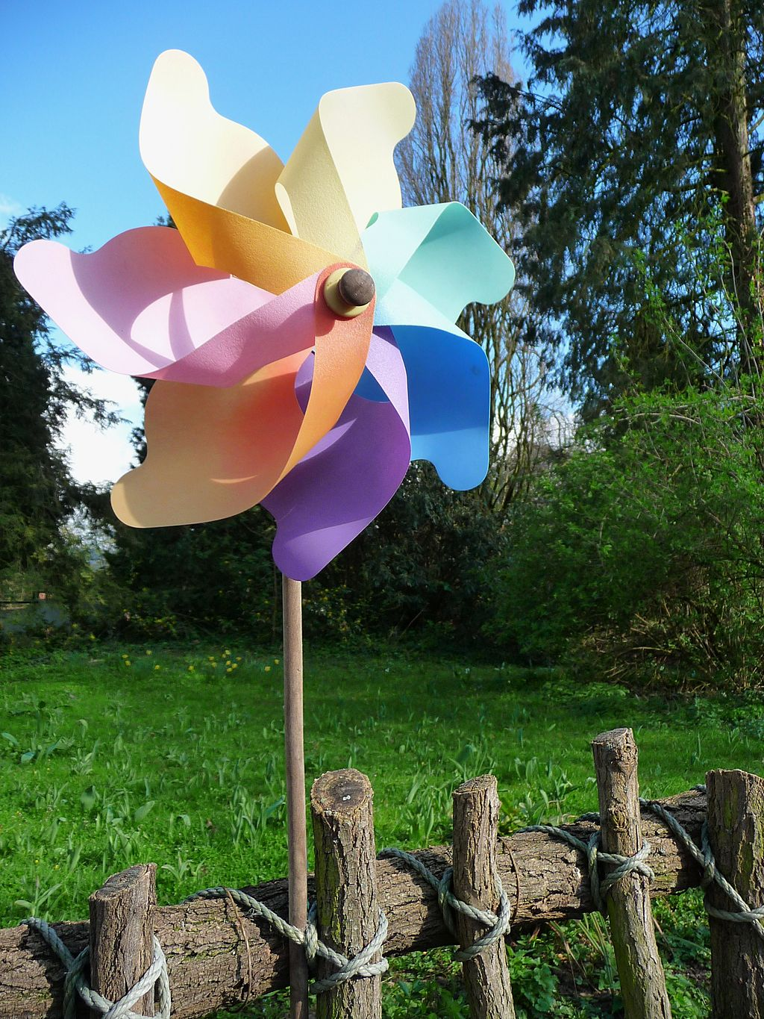
Flower power
Made from plastic and wood
4028mdk09, Colourful pinwheel http://commons.wikimedia.org/wiki/File%3ABuntes_Windrad.JPG
CC BY-SA 3.0 creativecommons.org/licenses/by-sa/3.0/deed.en

Slide 7
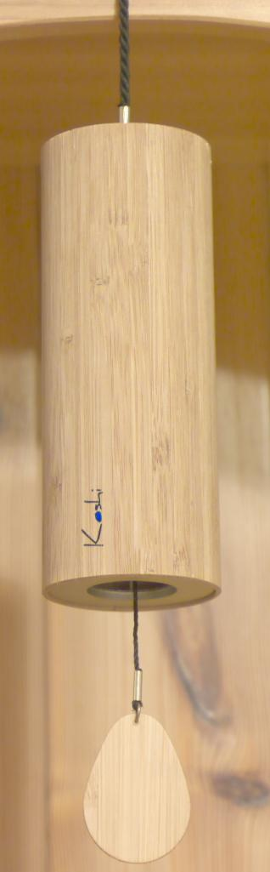
Wood wind
Made from wood, metal and string
Wind chime http://commons.wikimedia.org/wiki/File%3AWindglockenspiel.Koshi.jpg

Slide 8
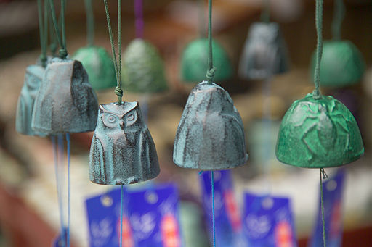
Beautiful bells
Made from metal and fishing line
Wind-chime http://commons.wikimedia.org/wiki/File%3AWind-chime-M7547.jpg

Slide 9
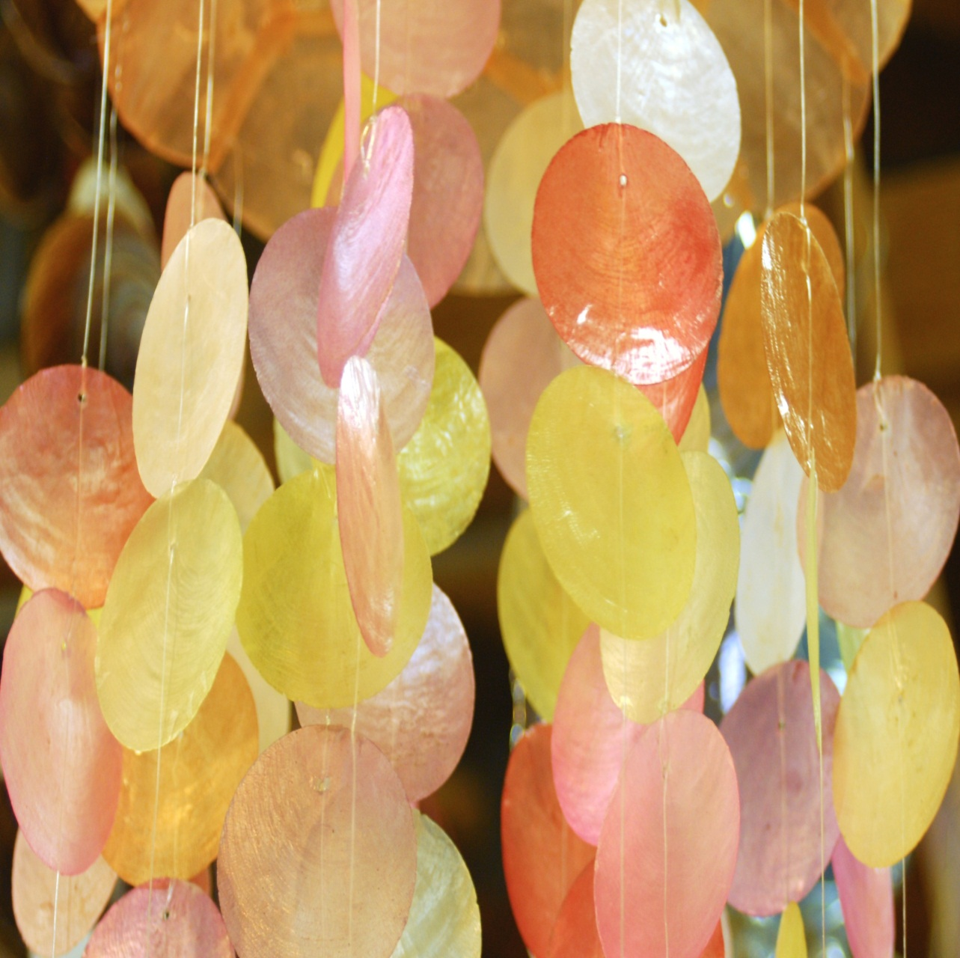
Tinkling shells
Made from shells and fishing line
http://mrg.bz/Y7UWHW

