Slide 1
What would a weather scientist say?

Slide 2
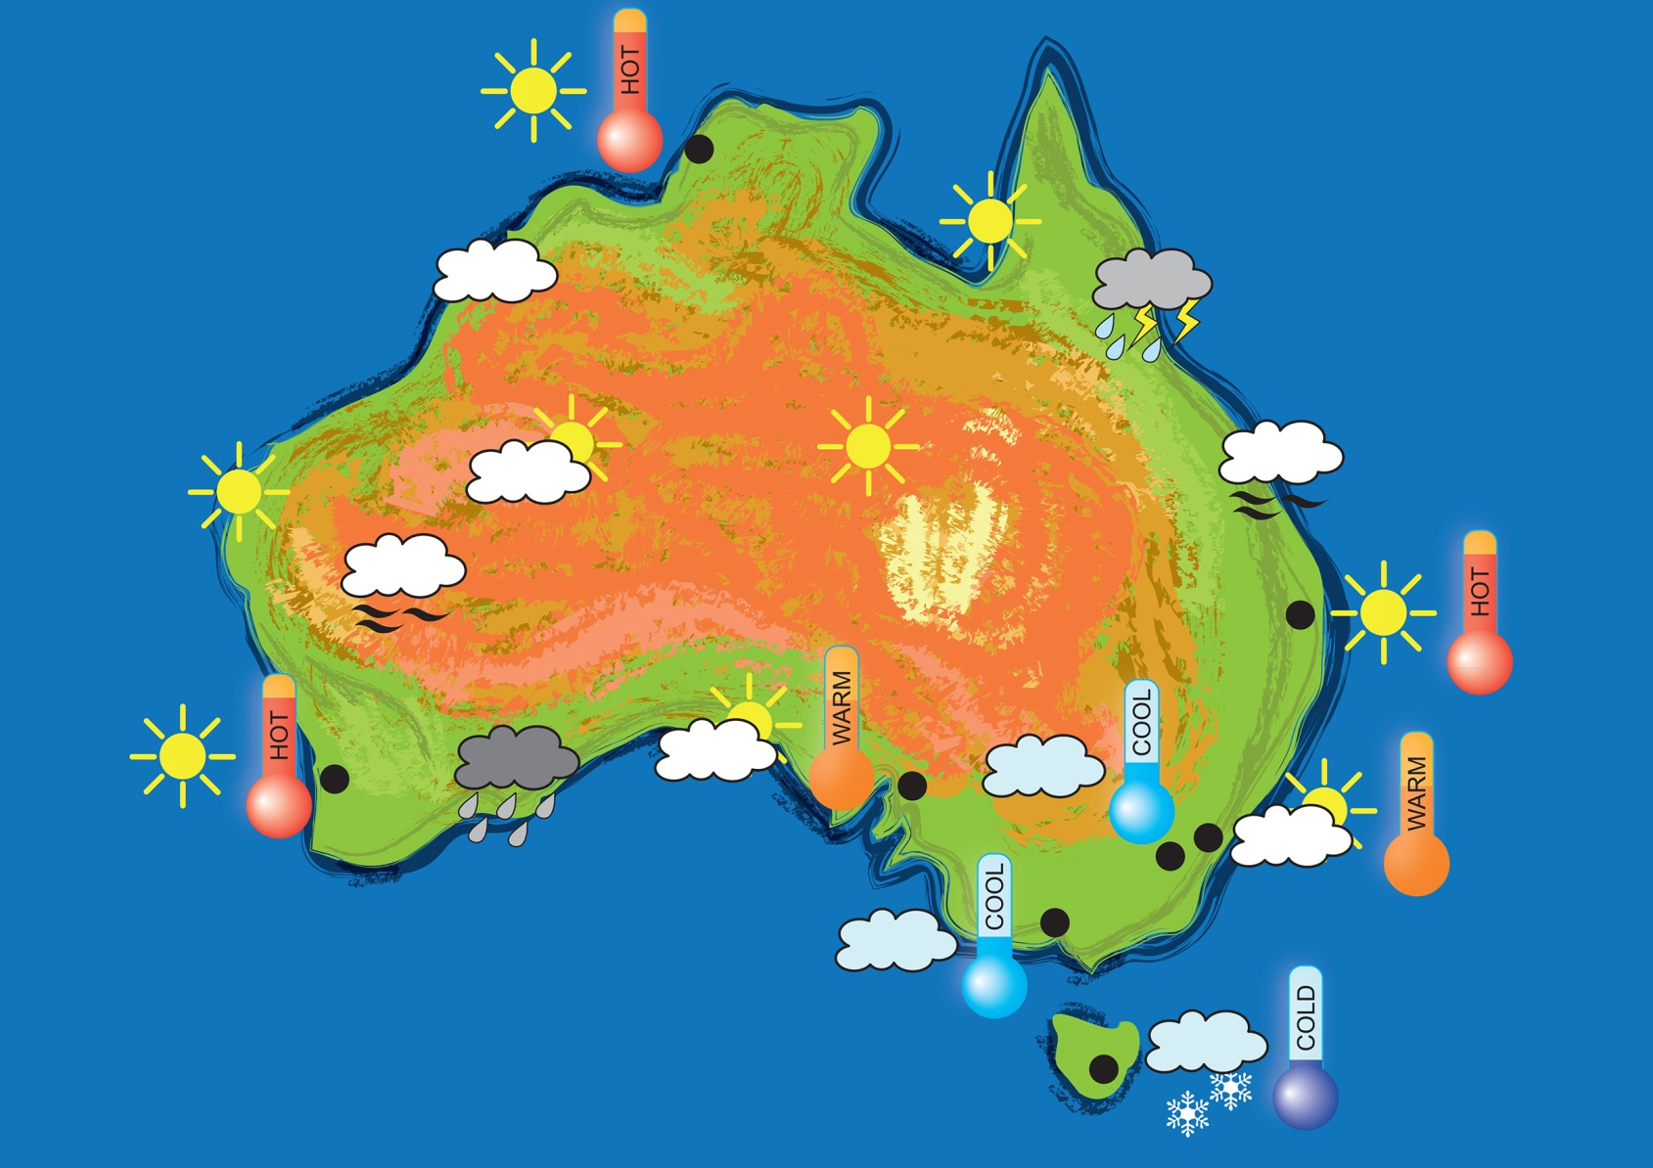
This is a weather map showing the weather forecast. Notice all of the symbols used.

Slide 3
Look at the following pictures and discuss what signs of weather you can see.
Then decide which symbols
could be used to show the weather.

Slide 4
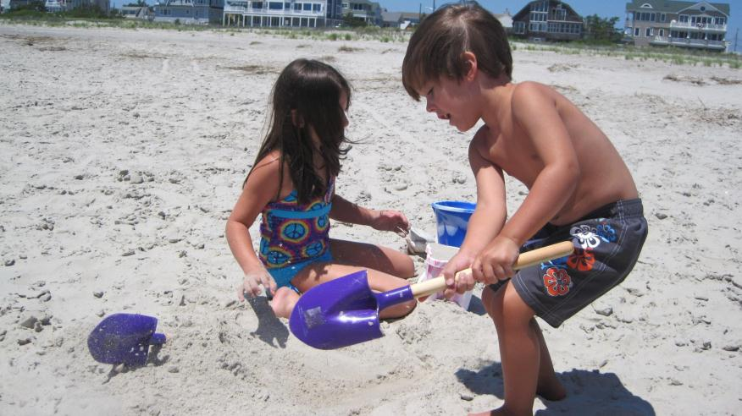

Slide 5
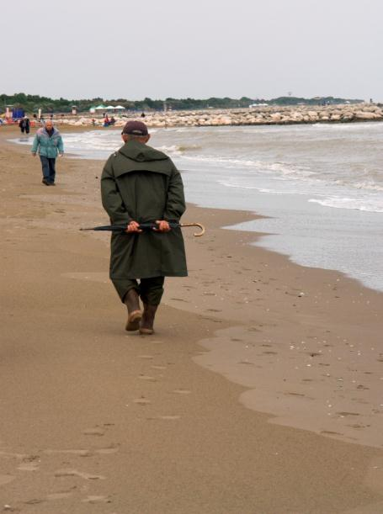

Slide 6
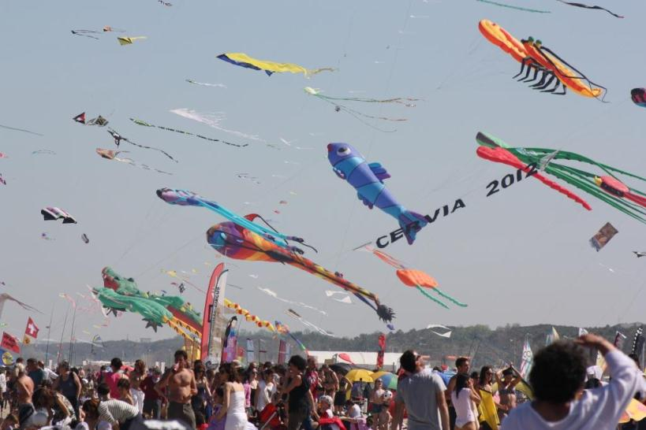

Slide 7
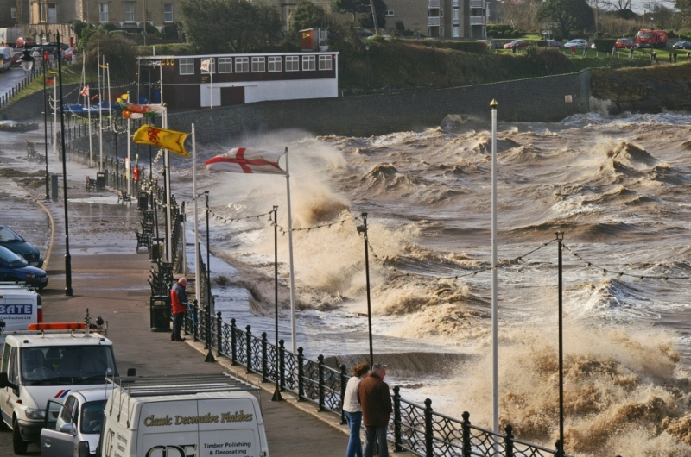

Slide 8
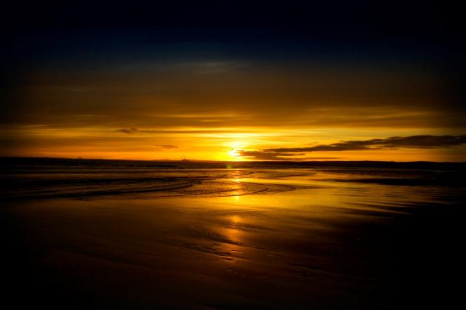
Why can’t we describe how warm or cold it is?

Slide 9
Attributions
Slide 2: DET image with clipart from www.clker.com
Slide 4: dee, IMG 1790, http://mrg.bz/nxSSB0
Slide 5: Gabor, Karpati, mgf36, http://mrg.bz/QWLy5S
Slide 6: rezdora70, IMG_2831, http://mrg.bz/1MGzsM
Slide 7: Jusben, Spring-tide-12-03-08-1005, http://mrg.bz/eE7Y7T
Slide 8: demondimum, sunrise5, http://mrg.bz/NKeQZu

