Slide 1
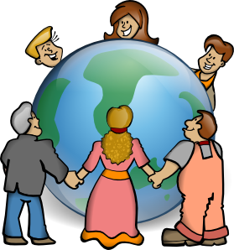
How weather affects clothing choices in other places
Notes:
How weather affects clothing choices in other places.
This slideshow shows photos of people who live in other places around the world. As you watch, look at what the people are wearing and doing for clues about the weather that is affecting them. You may also notice differences because of their culture. Culture means the way the people in a particular place live their lives.

Slide 2

Australia
People live in very many different places on Earth. The weather where they live affects the clothes they wear and their activities. Even in Australia the weather in one part will be very different from the weather in other parts.
Notes:
People live in very many different places on Earth. The weather where they live affects the clothes they wear and their activities. Even in Australia the weather in one part will be very different from the weather in other parts.

Slide 3
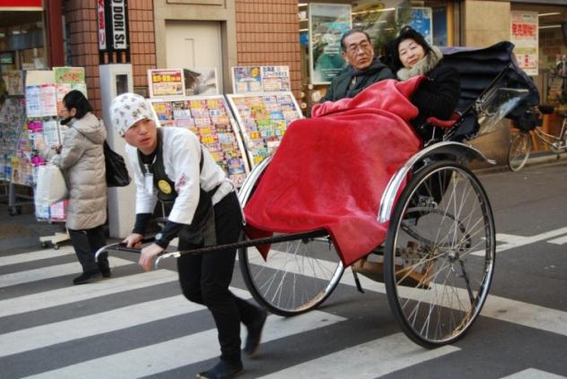
Japan
Notes:
This photo is taken in Japan and these people are riding in a rickshaw. Look at the photo for clues about what the weather is like. (pause)
Can you see the warm coats the older people are wearing and the cosy red blanket over their legs? Perhaps the young man pulling the rickshaw isn't feeling the cold as much because pulling the rickshaw makes him warm.

Slide 4
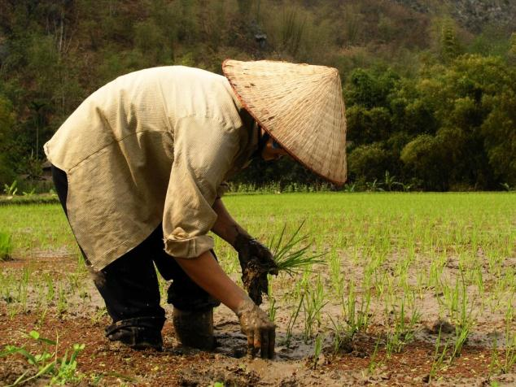
China
Notes:
This person lives in a part of China where they grow rice. Rice grows best in countries with a certain type of weather. Notice how far in to the wet mud the persons legs have sunk. The mud is very wet. Think about other clues that tell you about the weather in this picture. (Pause)
Rice grows best in places that are hot with lots of rain. This person is wearing work clothes that protect them from getting burned in the sun. Their shirt is loose and their hat has a wide brim to keep them cool. Their choice of clothes is affected by the weather.

Slide 5
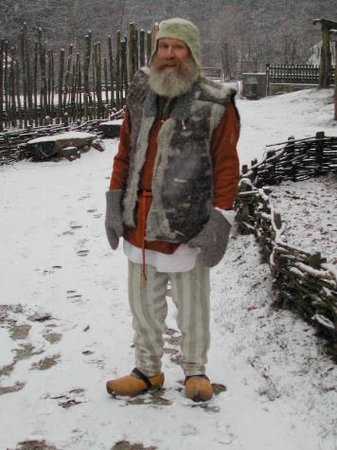
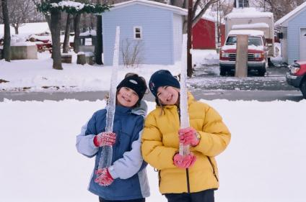
Canada
Holland
Notes:
The people in these photos have chosen their clothes because of the weather. Notice what they are all wearing on their hands and heads. The girls are in a country called Canada and the man is in a country called Holland. The man is wearing special wooden shoes known as clogs with very thick socks. Before modern boots were invented, these were worn by lots of people in Holland to protect their feet from the weather. Of course the weather in these photos is very cold and snowy.

Slide 6
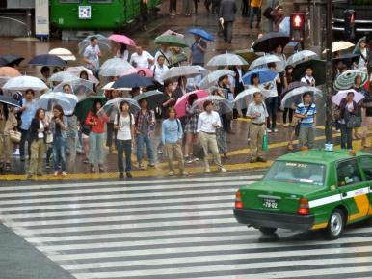
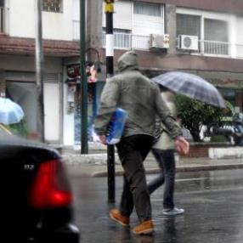
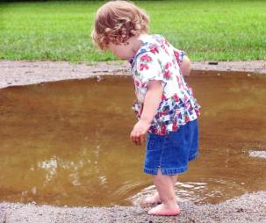
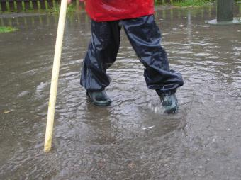
Warm and rainy
Cold and rainy
Notes:
All these photos are showing rainy weather. But can you see that their clothing is different? (pause)
In some places it can rain but still be hot or warm. In other places it can be very cold when it rains. The type of weather affects the clothes we choose to wear.

Slide 7
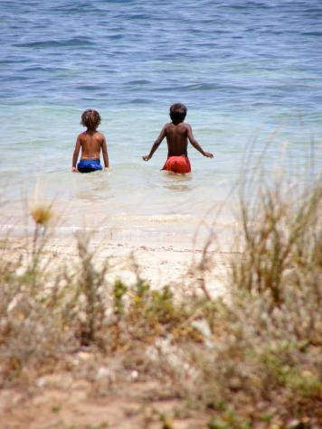
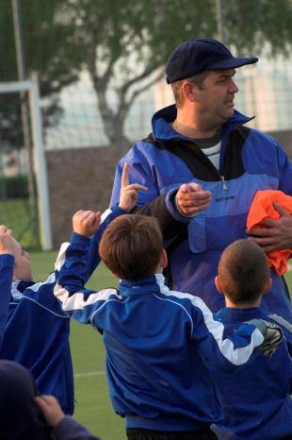
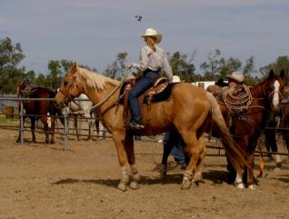
Clothes for some weather in Australia
Notes:
All these photos were taken in Australia. You can work out the weather by looking at what the people are wearing and also by what they are doing. Think about where in Australia you live and what the weather is like right now. How is this affecting what you are wearing?

Slide 8
Attributions
Slide 1: Jonata, Embrace the world, https://openclipart.org/detail/4807/embrace-the-world
Slide 2: Ocal, Globe clip art, http://www.clker.com/clipart-2123.html
Slide 3: CarolinaJG, Tokyo_taxi_3, http://mrg.bz/0Toleh
Slide 4: Chilombiano, Chilombiano_P2222191, http://mrg.bz/1rYxFI
Slide 5: (L to R)
Bjwebbiz, Bjwebbiz_2-3-2007-13, http://www.morguefile.com/archive/display/158781
keeshu, kh-snowman, http://mrg.bz/q2rP6g
Slide 6: (L to R)
Seemann, P1040377, http://mrg.bz/uQsVG9
Alvimann , Pedestrians_under_Rain_7207 (5), http://mrg.bz/01wmSJ
anitapeppers , mudpuddlegirl, http://mrg.bz/3Tzkg7
lemort , MoF_2005_11, http://mrg.bz/wCQC61
Slide 7: (L to R)
S349142, PC270070, http://mrg.bz/mRosD8
s349142, s349142_P5120155, http://mrg.bz/hWI4aX
Gabor, Karpati , _ICT4843-01, http://mrg.bz/8mUbxt

