Slide 1
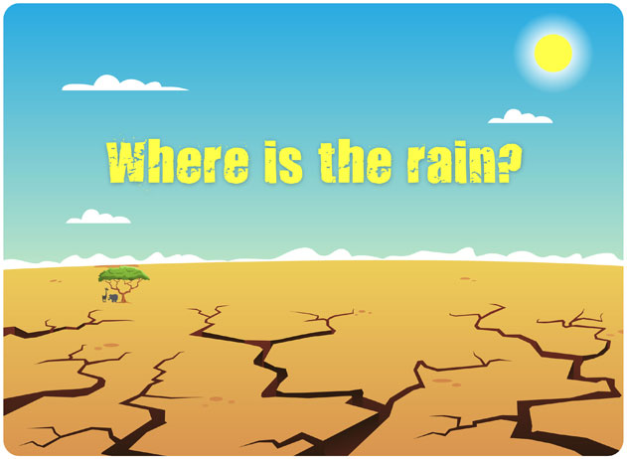
Illustrations © DET. Traditional African poem.

Slide 2
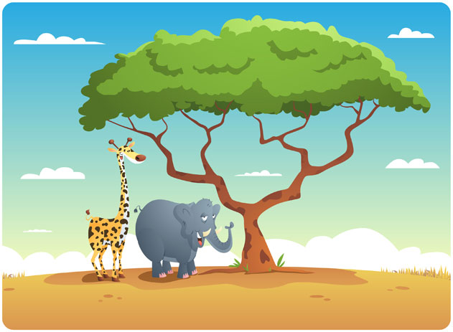
The giraffe and the elephant went for a walk.
They stopped in the shade and started to talk.

Slide 3
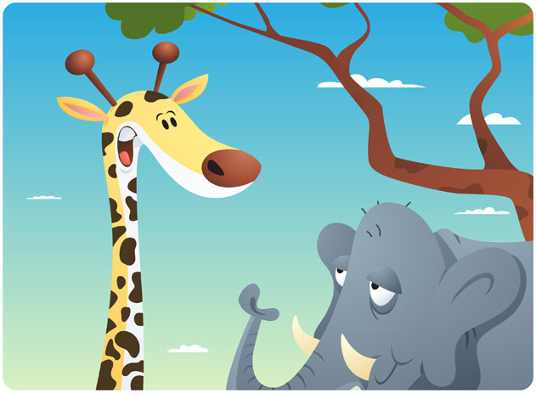
'I wish it would rain,' said the giraffe with a sigh,
'I'm tired of watching the clouds pass us by!'

Slide 4

‘Yes,’ said the elephant, ‘Where is the rain?
I wish I could eat fresh green leaves again.’

Slide 5
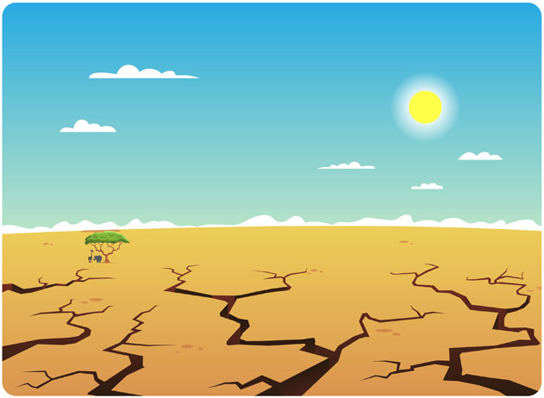
‘The sun is so hot and the land is so dry.
When will the rain fall from the sky?'

Slide 6
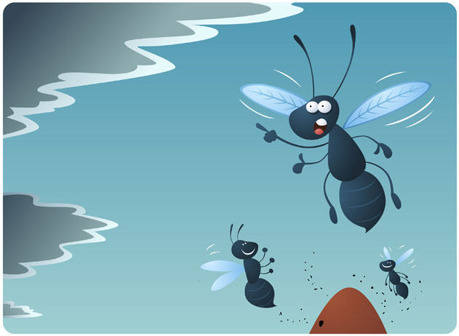
Later in the day the sky turned grey.
The flying ants flew out to say,

Slide 7
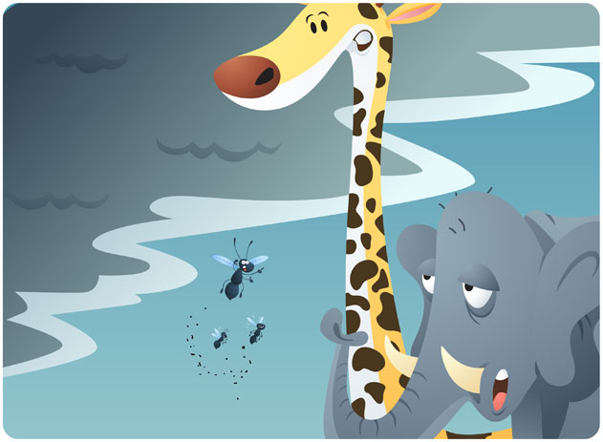
'The rain is coming! We smell it in the air!
And in the distance, thunder we hear!'

Slide 8
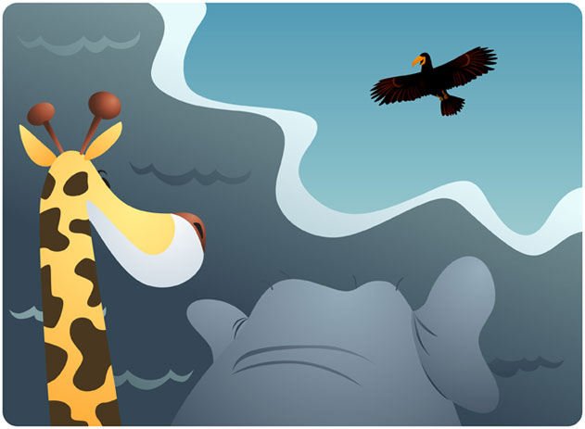
The giraffe and the elephant looked up at the sky and heard the black eagle give forth his cry,

Slide 9
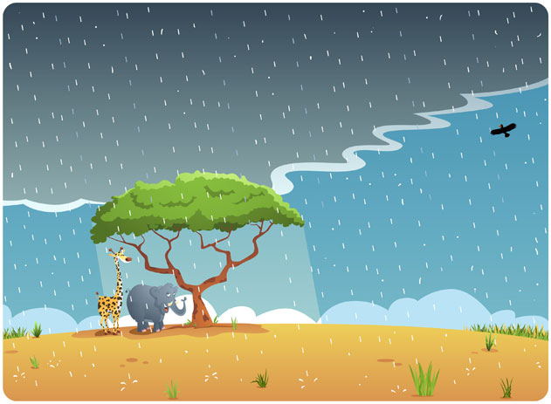
'The rain has come, the rivers will flow.
The dry season is over, now the green grass will grow!'

