Slide 1
Actions that harm environments

Slide 2
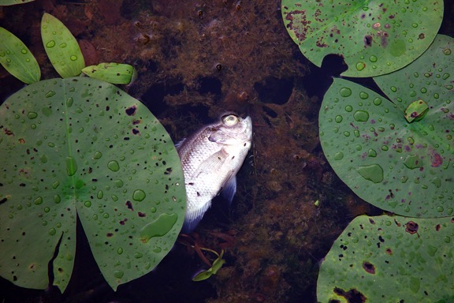
Living things find it difficult to survive in unhealthy environments.

Slide 3
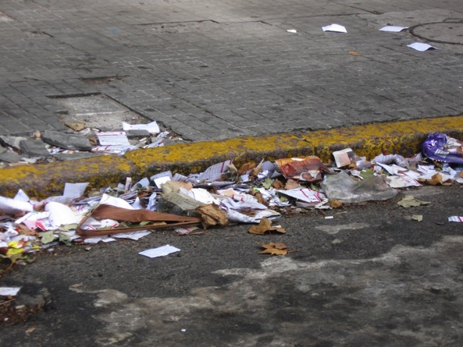
What do you observe in this picture?
What could people do about this?

Slide 4
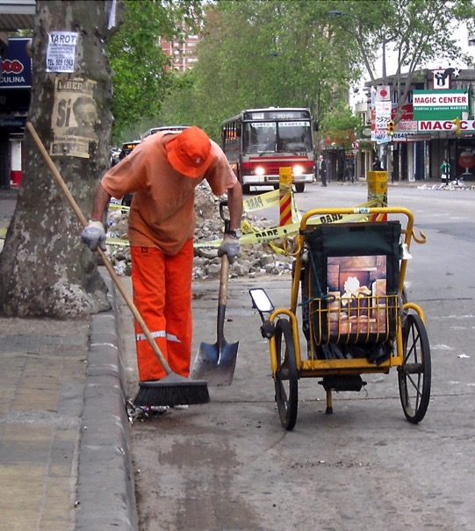

Slide 5
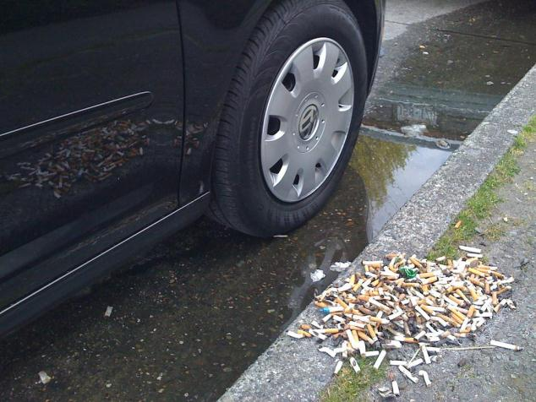
What do you observe in this picture?
What could people do about this?

Slide 6
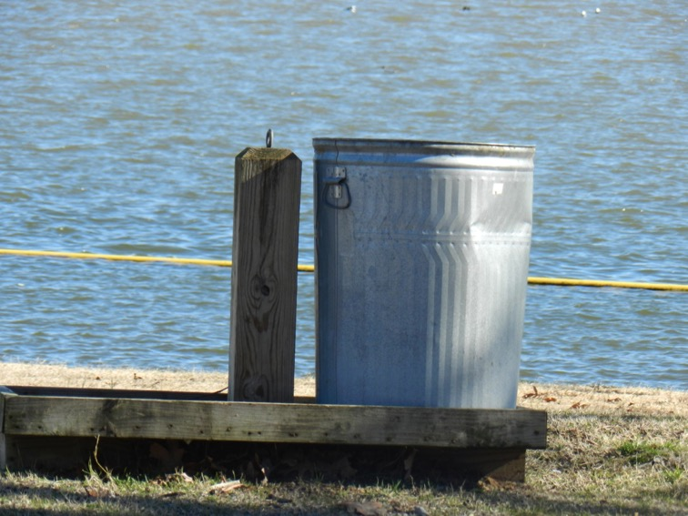

Slide 7
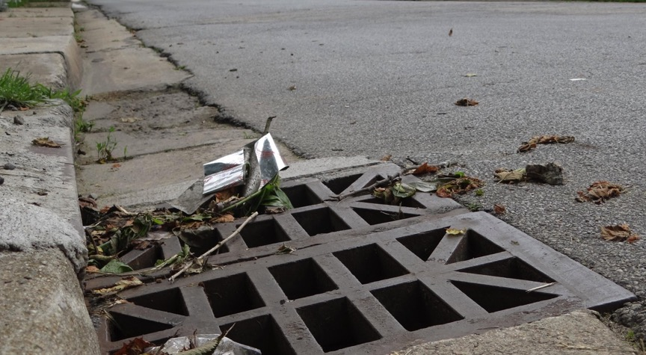
What do you think happens to rubbish left lying around?

Slide 8
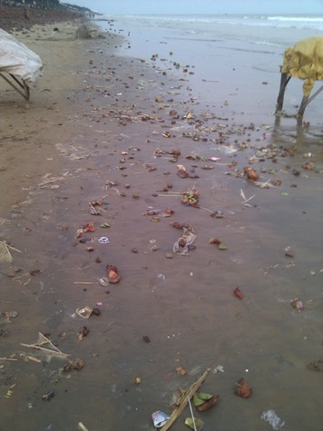
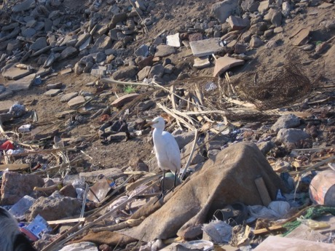
Where do you think
a lot of this rubbish ends up?
How might this impact
on living things?

Slide 9
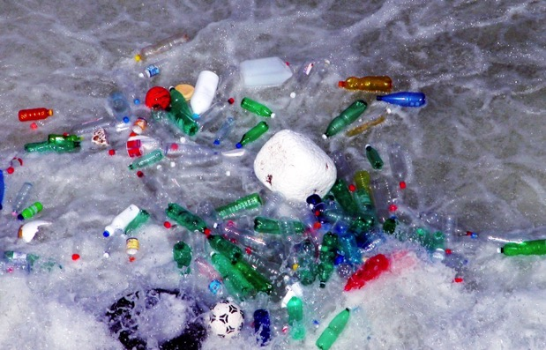
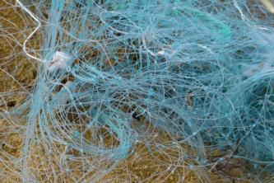
A lot of rubbish ends up in our oceans.
Animals such as birds, turtles, fish, whales and dugongs think it is food, or get tangled in it.

Slide 10
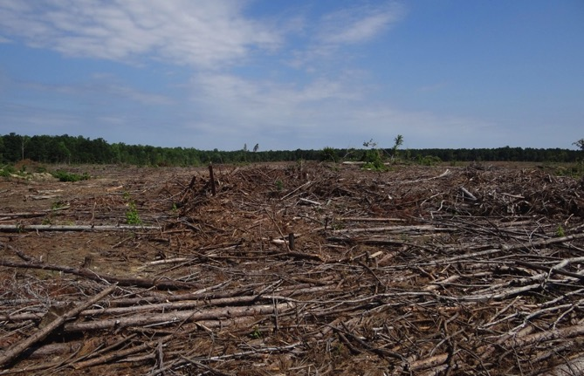
What do you observe in this picture??
How will this affect living things?

Slide 11
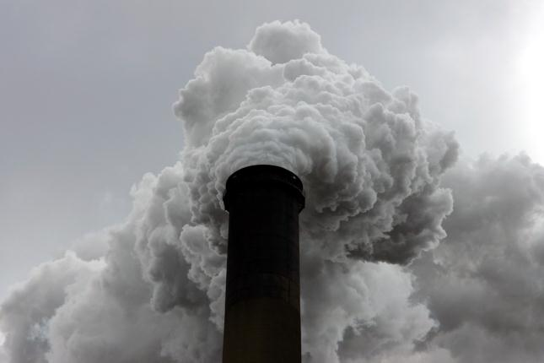
What do you observe in this picture??
How will this affect living things?

Slide 12
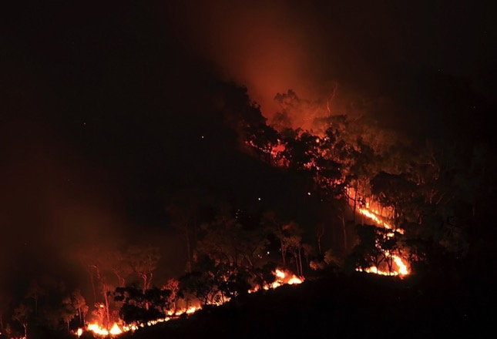
What human action may have caused this??
How will this affect living things?

Slide 13
Attributions
Slide 2: click, Fish, http://www.morguefile.com/archive/display/10721
Slide 3: Alvimann, City junk, http://www.morguefile.com/archive/display/725540
Slide 4: Alvimann, Garbage man, http://www.morguefile.com/archive/display/631298
Slide 5: buzzatsea, My car + trashola, http://www.morguefile.com/archive/display/850190
Slide 6: pippalou, Trash can, http://www.morguefile.com/archive/display/847472
Slide 7: DodgertonSkillhause, Drain, http://www.morguefile.com/archive/display/860604
Slide 8:
Ne0Freedom, Pollution in New Digha sea beach, http://commons.wikimedia.org/wiki/File%3APollution_in_New_Digha_Sea_Beach.jpg
3.0 creativecommons.org/licenses/by-sa/3.0/deed.en
vicky53, Jan07-borders-of-river-nile-egypt, http://www.morguefile.com/archive/display/179192
Slide 9:
clarita, Polluted, http://www.morguefile.com/archive/display/55021
robertojorge, Fishing net, http://www.morguefile.com/archive/display/844819
Slide 10: DodgertonSkillhause, Tree clearing, http://www.morguefile.com/archive/display/865907
Slide 11: click, Industrial, http://www.morguefile.com/archive/display/13507
Slide 12: wallyir, Bush Fire 2, http://www.morguefile.com/archive/display/619090

