Slide 1
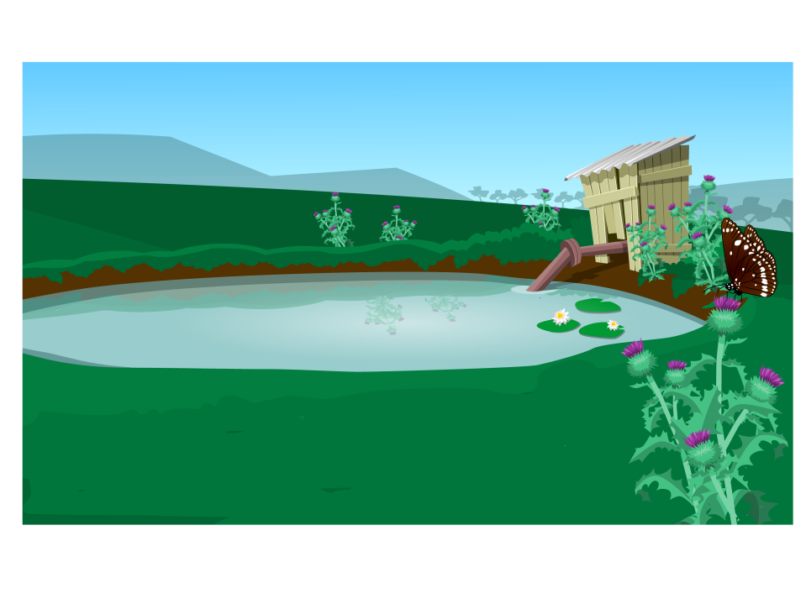
Photos from the farm
Sent by Gumnut
Sent by Gumnut

Slide 2
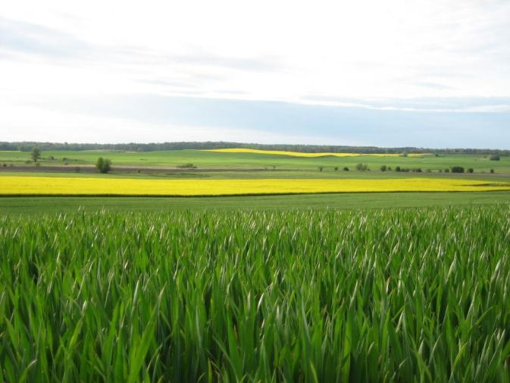
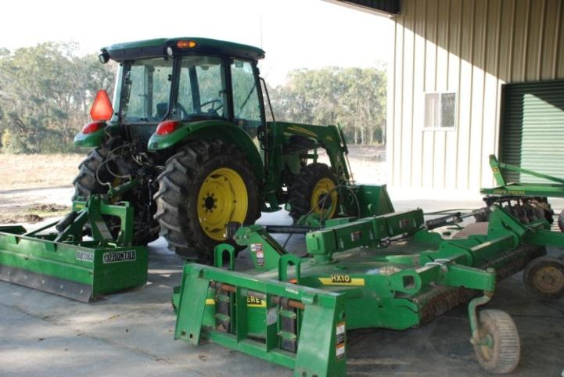
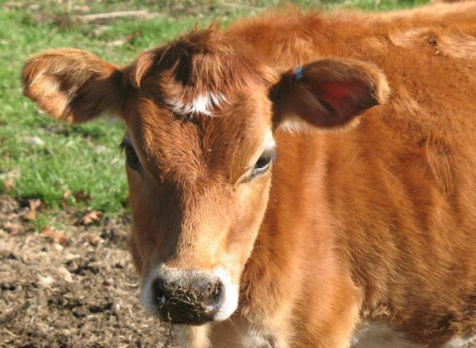
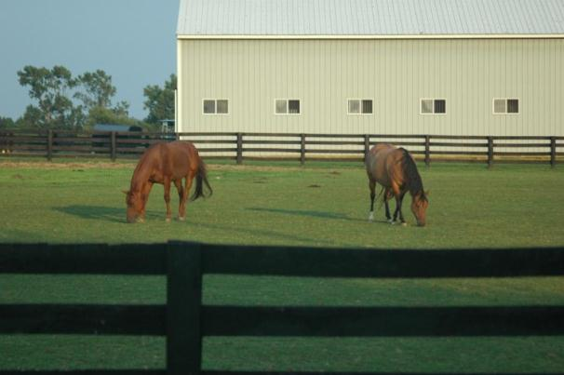
Do you know what a farm is?

Slide 3

A farm is…
… a piece of land or water which is used to grow plants or raise animals.
The plants and animals
then provide the
food which we buy in the shops
and supermarkets.

Slide 4
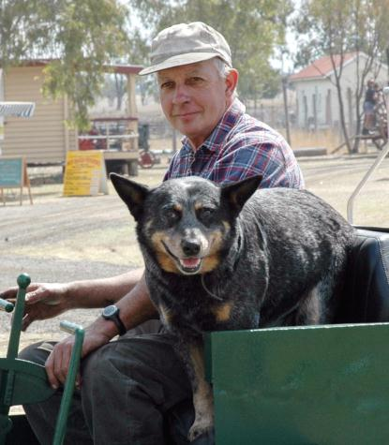
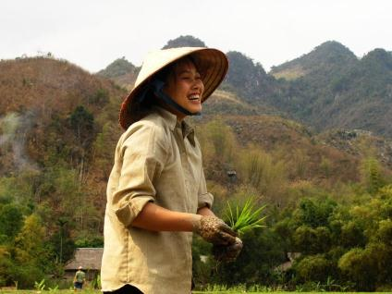
Who looks after the farm?
Farmers are men and women, young and old.

Slide 5
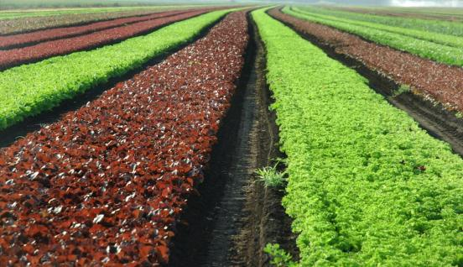
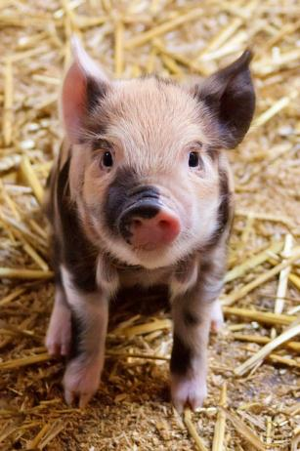
What do farmers do?
Farmers look after the animals and plants on their farm so they are healthy and grow well.

Slide 6
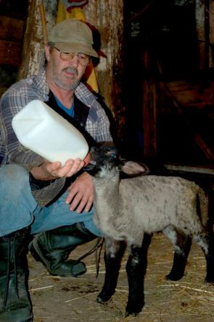
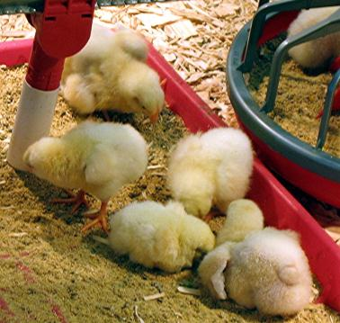
This means they provide for the needs of living things on their farm.
Food

Slide 7
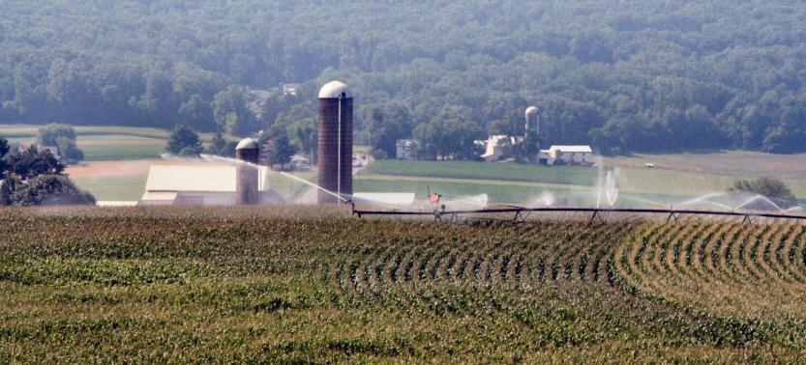
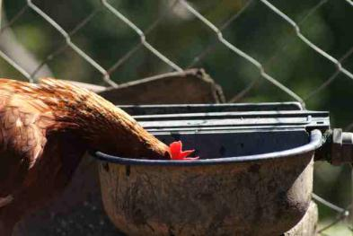
Water

Slide 8
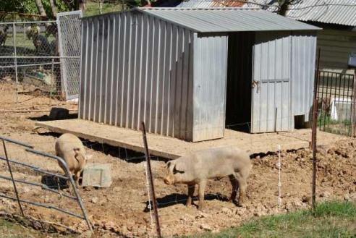
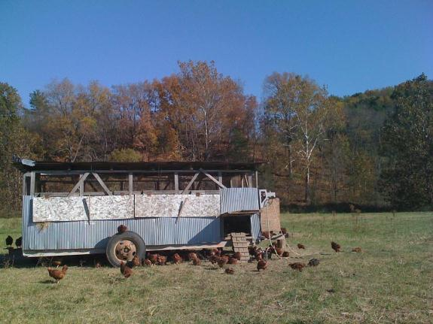
Shelter

Slide 9
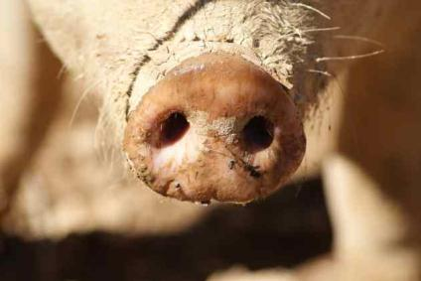
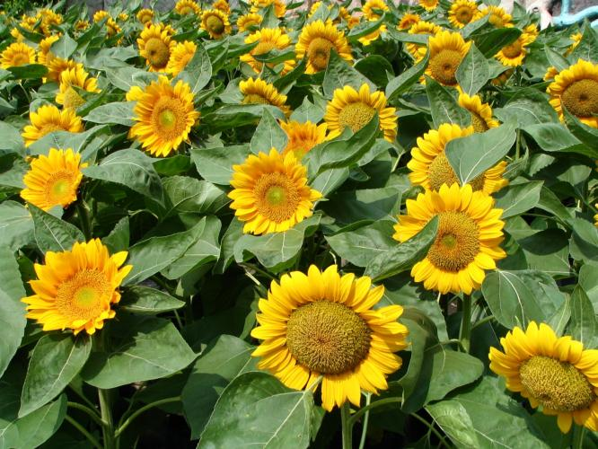
Of course,
the living things need fresh air, warmth
and light.

Slide 10
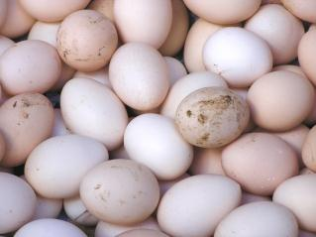
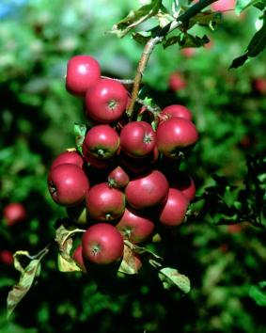
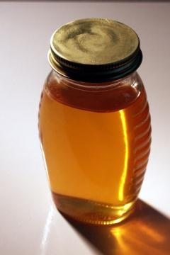
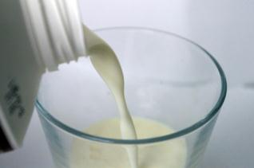
When their needs are met, the farm animals and plants help to meet our needs.

Slide 11
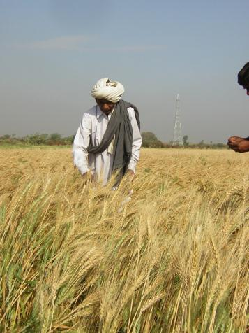
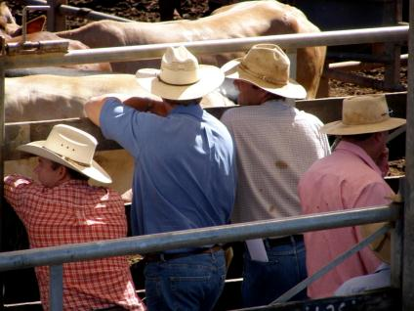
There are many types of farms all around
the world.

Slide 12
Attributions
Slide 2:
Cow, http://www.morguefile.com/portfolio/display/774316
Tractor, http://www.morguefile.com/archive/display/190476
Barn and horses, http://www.morguefile.com/archive/display/47302
Crops, http://www.morguefile.com/archive/display/167298
Slide 4:
Farmer with dog, http://www.morguefile.com/archive/display/33280
Rice farmer, http://www.morguefile.com/archive/display/159462
Slide 5:
Crops, http://www.morguefile.com/archive/display/221825
Piglet, http://pixabay.com/en/agriculture-animal-baby-cute-84702/
Slide 6:
Feeding lamb, http://www.morguefile.com/archive/display/66614
Chickens, http://www.morguefile.com/archive/display/142956
Slide 7:
Irrigation, http://www.morguefile.com/archive/display/765936
Chicken drinking. Image courtesy of: Narinda Sandry.
Used with permission.
Slide 8:
Chicken bus, http://www.morguefile.com/archive/display/850238
Pig shelter. Image courtesy of: Narinda Sandry.
Used with permission.
Slide 9:
Pig snout. Image courtesy of: Narinda Sandry.
Used with permission.
Sunflowers, http://www.morguefile.com/archive/display/119316
Slide 10:
Eggs, http://www.morguefile.com/archive/display/629755
Milk, http://www.morguefile.com/archive/display/838699
Apples, http://www.morguefile.com/archive/display/666271
Honey, http://www.morguefile.com/archive/display/98896
Slide 11:
Grain farmer, http://www.morguefile.com/archive/display/149564
Cattle farmer, http://www.morguefile.com/archive/display/164582
All other images © DETE.

