Slide 1












Move it, move it: Living things

Slide 2
All living things move or have moving parts.
Let’s start with animals.

Slide 3
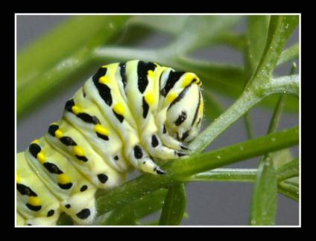
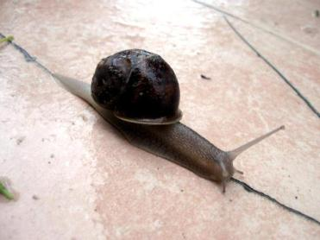
Some animals move from place to place in one main way. Can you describe how these animals move?
slide
crawl

Slide 4
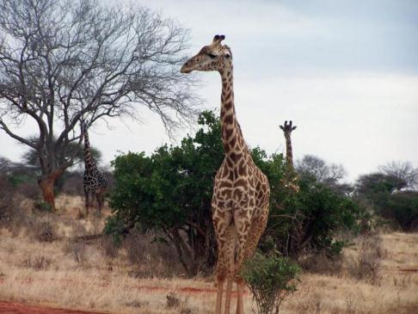
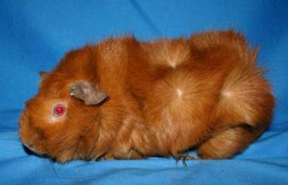
Other animals move from place to place in two main ways. Can you describe how these animals move?
walk and
run

Slide 5
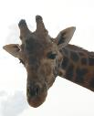

But do and
run and walk in the same way?
What do you think affects how they walk and run?
Is it their shape and size?

Slide 6
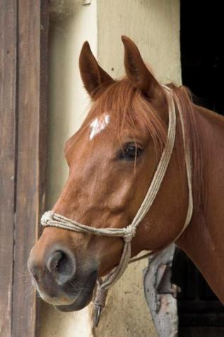
Some animals move from place to place in lots of different ways.
Can you think of ways a horse can move from place to place?

Slide 7
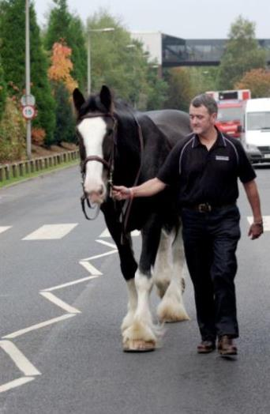
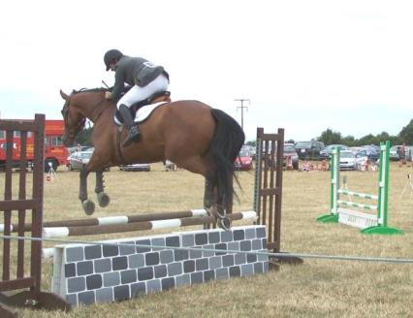
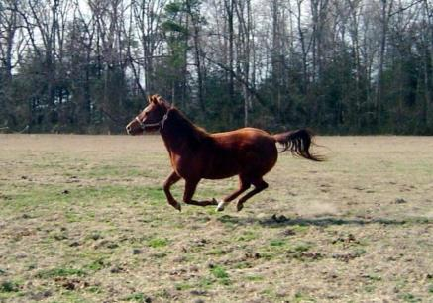
Horses can …

Slide 8
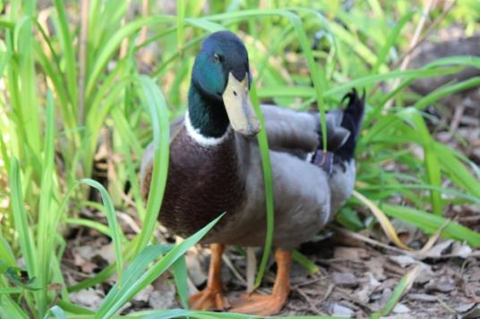
What about ducks?
Can you think how ducks move from place to place?

Slide 9
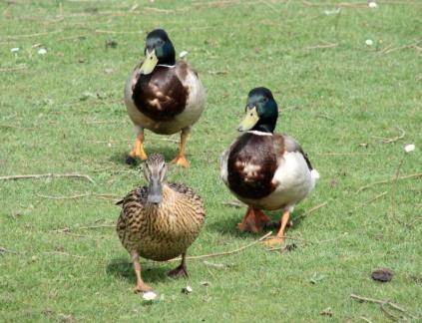
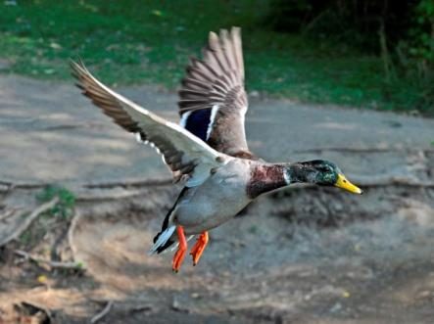
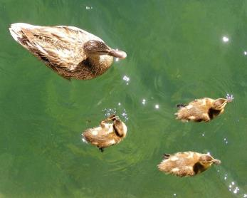
Ducks can …

Slide 10
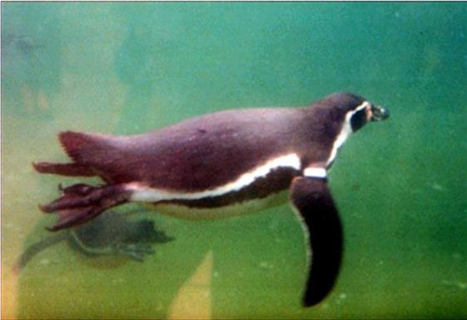
Many birds can walk, swim and fly. But NOT ALL birds can move around in these ways.
Penguins are great underwater swimmers. Look at this penguin’s shape.

Slide 11
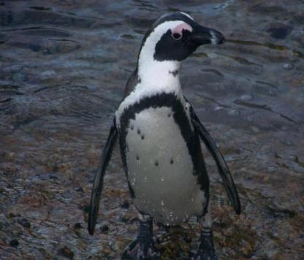
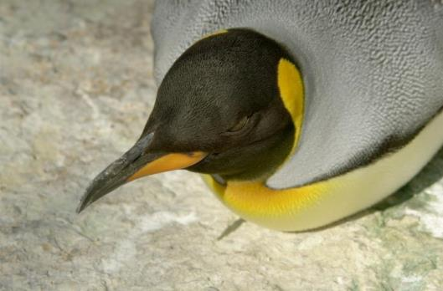
They walk and even slide to move from place to place. But they cannot fly.

Slide 12
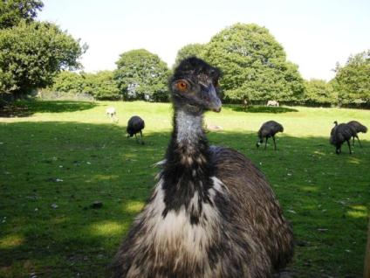
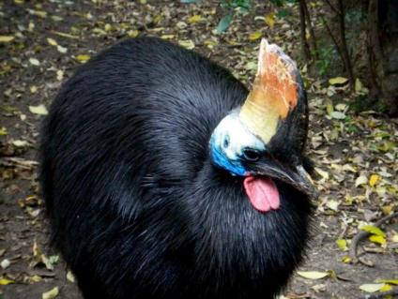
Emus and cassowaries can run very fast and kick with their strong legs, but they cannot fly.
Can you think why? (Clue: Look at their shape and size.)

Slide 13
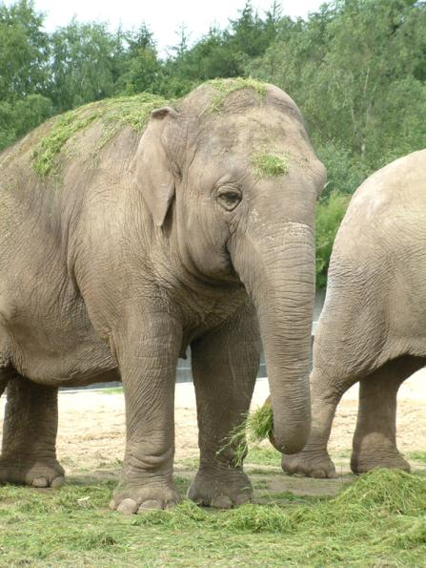
How does an elephant’s size and shape affect how it moves?

Slide 14
… an animal’s size and shape affect how it moves.
Science tells us that …

Slide 15
We’ve talked about animal movements … but what about plants?
Do plants move?

Slide 16





Plants don’t move in the same ways as animals.
Have you ever seen a plant walk, run, swim, jump, slide or fly?
NO!

Slide 17
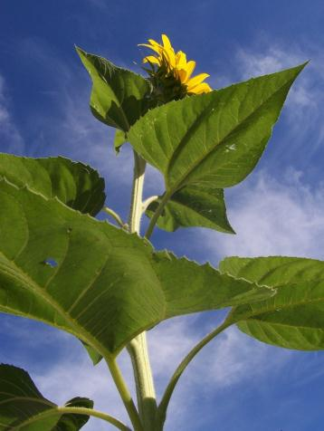
But plants do move.
The leaves of sunflower plants move to follow the sun throughout the day. During the night, the plant moves its leaves back to face where the sun will rise.
(The flower buds grow to face the rising sun and then stay in this position.)

Slide 18
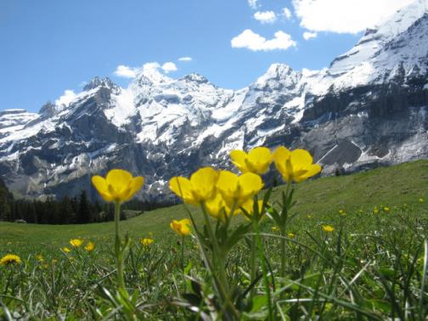

The flowers of buttercups that grow in cold, snowy mountains track the sun throughout the day. Scientists think this helps the flowers to collect more heat to warm the pollen and the insects that visit them.
The flowers warm me up so I can fly faster and visit more flowers.

Slide 19
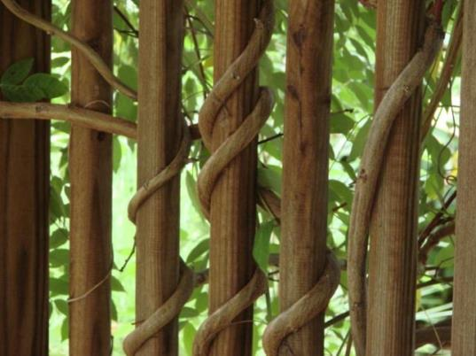
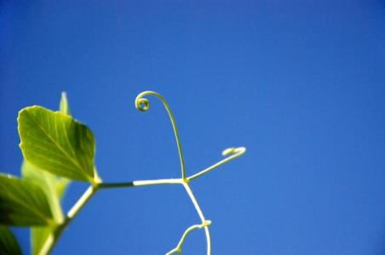
Vines
Vines bend as they grow. They send out tendrils to find something to grow around.

Slide 20


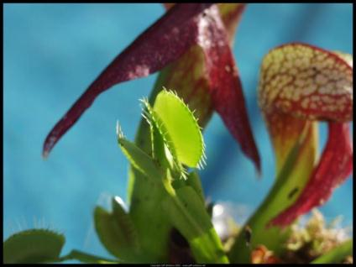
Some plants are meat eaters!
The leaves of a Venus flytrap plant have tiny hairs that ‘feel’ insect movements. When an insect walks over the hairs, the leaves SNAP shut. It takes as long as one clap with your hands. The more the insect struggles, the more the leaves close tighter. They stay closed for one to two weeks while the plant soaks up the insect juices. The leaf shape and parts inside the plant make this possible.
Visit this website to watch a video of Venus flytraps.
Venus flytrap (time lapse).wmv (YouTube, LearjetMinako) http://www.youtube.com/watch?feature=player_detailpage&v=PYMYxw4Llow

Slide 21
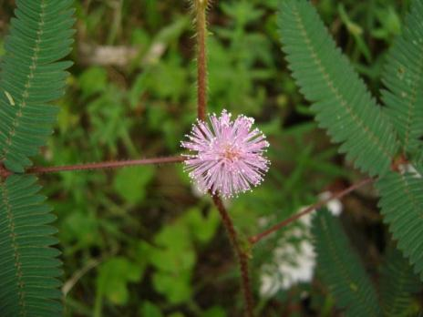
Other plants close when they are touched. Scientists think the plants could be trying to protect themselves.
Visit this website to watch a video of plants responding to touch.
Mimosa plants in Singapore south coast beach park (YouTube, epSos.de) http://www.youtube.com/watch?v=aoGi2_8groI

Slide 22
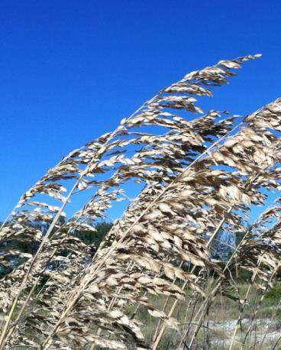
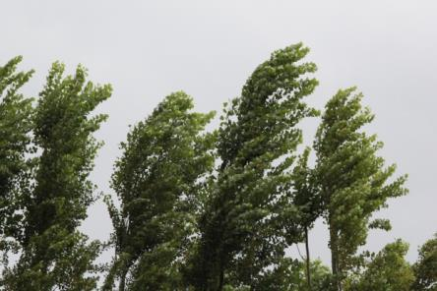
Plants are able to bend and sway in the wind.
If they weren’t shaped to do this they would break. Of course, sometimes they do snap when the wind is very strong.

Slide 23
Science tells us that the shape and size of animals and plants affect how they move or can be moved.

Slide 24
Attributions
Slide 1 — Clip art
OCAL, Left Foot Print, http://www.clker.com/clipart-2591.html
OCAL, Right Foot Print, http://www.clker.com/clipart-2595.html
OCAL, Raven Silhouette, http://www.clker.com/clipart-14842.html
OCAL, Hamster Silhouette, http://www.clker.com/clipart-16782.html
OCAL, Tree Silhouettes, http://www.clker.com/clipart-13120.html
OCAL, Twisted Branch 4, http://www.clker.com/clipart-twisted-branch.html
OCAL, Footprints, http://www.clker.com/clipart-1739.html
Halls, S, Black Paws, http://www.clker.com/clipart-black-paws.html
Tobin, K, Paw tracks, http://www.clker.com/clipart-paw-tracks.html
Slide 3 — Alvimann, Snail, http://www.morguefile.com/archive/display/637303 earl53, am_I_cute.jpg, http://www.morguefile.com/archive/display/170015
Slides 4 — xandert, Autum-20080221-IMG_4831.jpg, http://www.morguefile.com/archive/display/197311 biberta, Kenia giraffe, http://morguefile.com/p/232337
Slide 5 — xandert, Autum-20080221-IMG_4831.jpg, http://www.morguefile.com/archive/display/197311 (cropped) Giraffe head, Image courtesy of Deanne Blackmore. Used with permission.
Slide 6 — GaborfromHungary, _ICT4396-01.jpg, http://www.morguefile.com/archive/display/603980
Slide 7 — loneangel, in_mid_air.jpg, http://www.morguefile.com/archive/display/133203 bobby, DSC_0953.jpg, http://www.morguefile.com/archive/display/97748 Athena, 7_yc.jpg, http://www.morguefile.com/archive/display/190564
Slide 8 — Sgarton, IMG_8021.JPG, http://www.morguefile.com/archive/display/865859
Slide 9 — loneangel, follow_the_leader.jpg, http://www.morguefile.com/archive/display/117685 beglib, beglib_4_ducks_.jpg, http://www.morguefile.com/archive/display/144510 AcrylicArtist, Mallard in Flight.JPG, http://www.morguefile.com/archive/display/835688

Slide 25
Attributions
Slide 10 — Seeka, PIC1081922061.jpg, http://www.morguefile.com/archive/display/13882
Slide 11 — LeesyBee, penguin_wet.jpg, http://www.morguefile.com/archive/display/157821 bobby, 112161134516.jpg, http://www.morguefile.com/archive/display/74785
Slide12 — img231.jpg, TheLoon, http://www.morguefile.com/archive/display/156920 AJenyon, ajenyon_100_1321.JPG, http://www.morguefile.com/archive/display/191022
Slide 13 — Ariadna, 08_Loveparken.jpg, http://www.morguefile.com/archive/display/58710
Slide 16 — OCAL, Cartoon veggies running, http://www.clker.com/clipart-9736.html OCAL, Tree, http://www.clker.com/clipart-2533.html Wing 2, http://www.clker.com/clipart-wing2.html Smiley eyes, http://www.clker.com/clipart-28689.html
Slide 17 — anitra, sunflower_tall.jpg, http://www.morguefile.com/archive/display/8202
Slide 18 — badeendjuh, IMG_8642.JPG, http://www.morguefile.com/archive/display/821238 Bee, http://www.clker.com/clipart-11559.html
Slide 19 — Pennywise, CurlyVines070407__7_.JPG, http://www.morguefile.com/archive/display/217300 mrmac04, GeoDSC00057_o.JPG, http://www.morguefile.com/archive/display/225937
Slide 20 — helicopterjeff, pets0000176.jpg, http://www.morguefile.com/archive/display/85045 Housefly, http://www.clker.com/clipart-11552.html
Slide 21— Heraldoluciano, Dormideira \(Mimosa pudica\), http://www.morguefile.com/archive/display/683409;
Slide 22 — Pedrojperez, IMG_3634.JPG, http://www.morguefile.com/archive/display/868440 MGDboston, reeds sea oats bloom MGD©.JPG, http://www.morguefile.com/archive/display/928431

