Slide 1
People who work with movement

Slide 2
We use movement every day in many ways, and most of the time we don’t even think about it.
But some people have jobs that need them to think carefully about how objects and bodies move.
Can you think of any?
The following slides show some ideas.

Slide 3
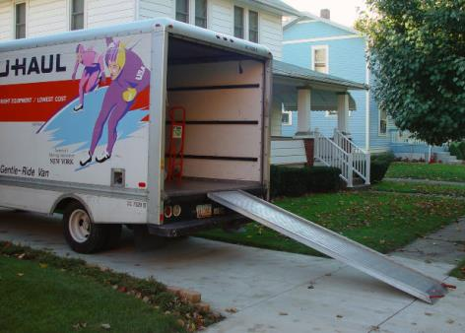
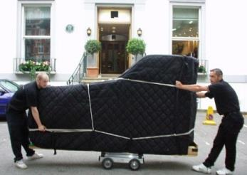
Removalists
How do size and shape affect movement in this job?

Slide 4
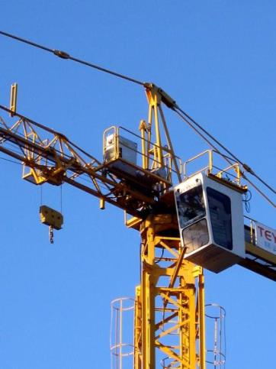
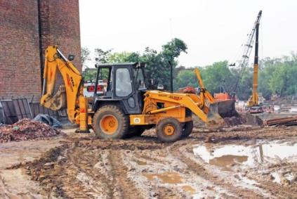
Drivers
How do size and shape affect movement in this job?

Slide 5
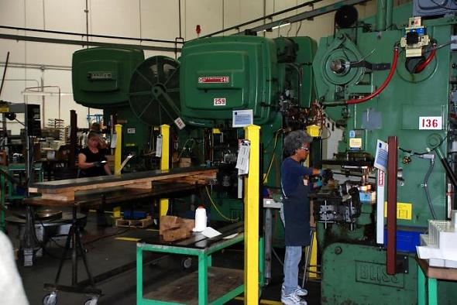
Machine operators
How would knowing about the size, shape and movement of the parts in this machine affect the safety of the person in this job?

Slide 6
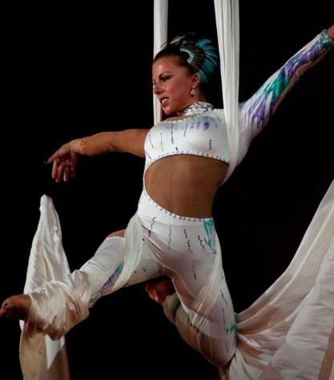
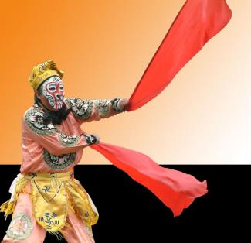
Dancers and acrobats
How do size and shape affect movement in these jobs?

Slide 7
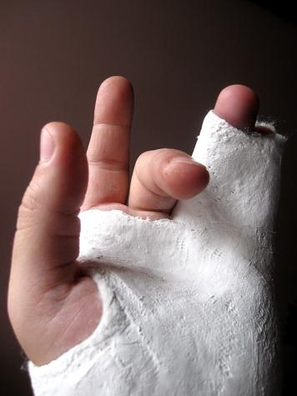
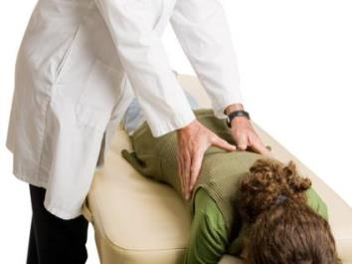
Doctors and physiotherapists
How would knowing about the size, shape and movement of the parts be used in these jobs?

Slide 8
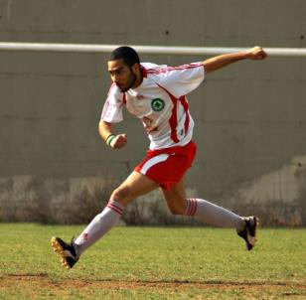
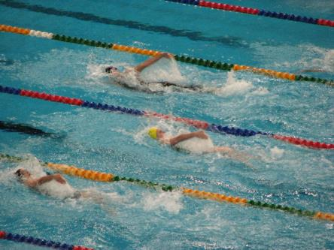
Sports people
How do sports people use their knowledge of shape and size to affect their movement?

Slide 9
Attributions
All slides (background): © DET
Slide 3: click, uhaul.jpg, http://www.morguefile.com/archive/display/67807
KARRAX, Piano removals Christchurch.jpg, http://commons.wikimedia.org/wiki/File:Piano_Removals_Christchurch.jpg
CC BY-SA 3.0 creativecommons.org/licenses/by-sa/3.0/
Slide 4: Alvimann, Crane_3419 (2).JPG, http://www.morguefile.com/archive/display/669509 singhajay, DSC_5292Aj.jpg, http://www.morguefile.com/archive/display/211891
Slide 5: phaewilk, Fender_041.jpg, http://www.morguefile.com/archive/display/850984
Slide 6: keyseeker, 20100410_4563.jpg, http://www.morguefile.com/archive/display/671265
anon, anon6e.jpg, http://www.morguefile.com/archive/display/46002
Slide 7: Alvimann, Broken_Fingers_4765 (24).JPG, http://www.morguefile.com/archive/display/682124
LilJoel, chiropractors Kent WA.JPG, http://www.morguefile.com/archive/display/805599
Slide 8: dtcreations, IMG_4477_a.JPG, http://www.morguefile.com/archive/display/163396
lisasolonkyo, soccer1.jpg, http://www.morguefile.com/archive/display/195449

