Slide 1
Objects that have multiple moving parts

Slide 2
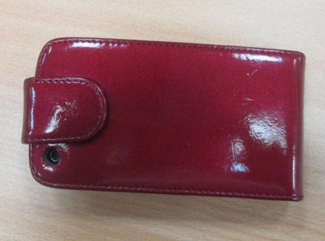
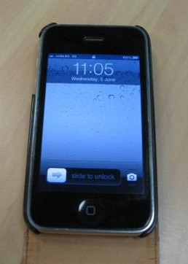
What movements can be made with this object?
swing
slide
press

Slide 3
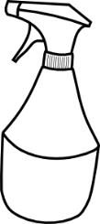
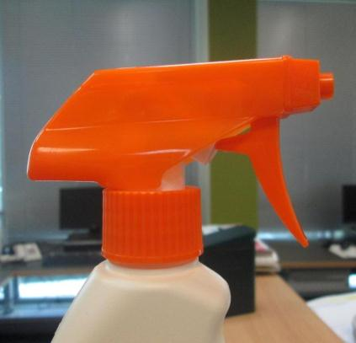
What movements can be made with this object?
turn
slide
spin
press

Slide 4
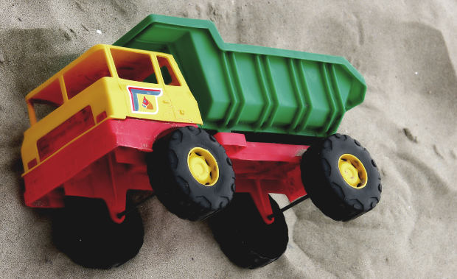
What movements can be made with this object?
roll
swing

Slide 5
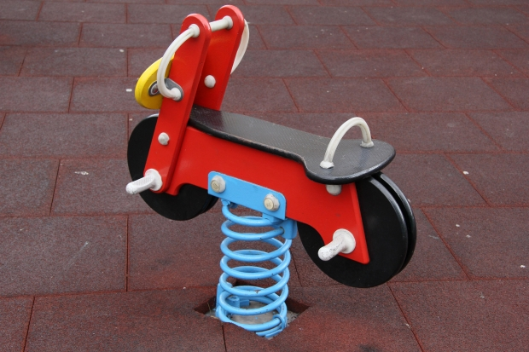
What movements can be made with this object?
bounce
bend

Slide 6
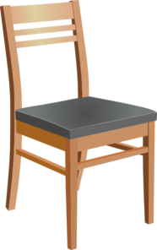
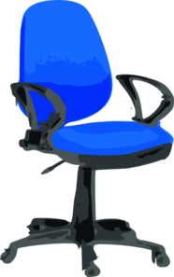
Do chairs have moving parts?
?

Slide 7
Attributions
Slide 2: All photos © DET
Slide 3: Squirt bottle clipart, http://www.clker.com/clipart-15766.html; Squirt bottle photo, © DET
Slide 4: Truck, http://www.morguefile.com/archive/display/153934
Slide 5: Ride-on toy, http://www.morguefile.com/archive/display/856839
Slide 6: Wooden chair, http://www.clker.com/clipart-wooden-chair.html; Blue desk chair with wheels, http://www.clker.com/clipart-220671.html

